Slide 1
Kubernetes Operator

Slide 2
Operator 模式
Operator 是 Kubernetes 的扩展软件，它利用 定制资源 管理应用及其组件。 Operator 遵循 Kubernetes 的理念，特别是在控制器 方面。
Operator 是由 CoreOS 开发的，用来扩展 Kubernetes API，特定的应用程序控制器，它用来创建、配置和管理复杂的有状态应用，如数据库、缓存和监控系统。

Slide 3
初衷
Operator 模式旨在捕获（正在管理一个或一组服务的）运维人员的关键目标。 负责特定应用和 service 的运维人员，在系统应该如何运行、如何部署以及出现问题时如何处理等方面有深入的了解。
在 Kubernetes 上运行工作负载的人们都喜欢通过自动化来处理重复的任务。 Operator 模式会封装你编写的（Kubernetes 本身提供功能以外的）任务自动化代码。

Slide 4
Kubernetes Operator
Kubernetes 为自动化而生。无需任何修改，你即可以从 Kubernetes 核心中获得许多内置的自动化功能。 你可以使用 Kubernetes 自动化部署和运行工作负载， 甚至可以 自动化 Kubernetes 自身。
Kubernetes 控制器 使你无需修改 Kubernetes 自身的代码，即可以扩展集群的行为。 Operator 是 Kubernetes API 的客户端，充当 定制资源 的控制器。

Slide 5
Kubernetes Operator
使用 Operator 可以自动化的事情包括：
按需部署应用
获取/还原应用状态的备份
处理应用代码的升级以及相关改动。例如，数据库 schema 或额外的配置设置
发布一个 service，要求不支持 Kubernetes API 的应用也能发现它
模拟整个或部分集群中的故障以测试其稳定性
在没有内部成员选举程序的情况下，为分布式应用选择首领角色

Slide 6
什么是Operator？
先复习一下Kubernetes。Kubernetes实际是期望状态管理器。先在Kubernetes中指定应用程序期望状态（实例数，磁盘空间，镜像等），然后它会尝试把应用维持在这种状态。Kubernetes的控制平面运行在Master节点上，它包含数个controller以调和应用达到期望状态：
检查当前的实际状态（Pod、Deployment等）
将实际状态与spec期望状态进行比较
如果实际状态与期望状态不一致，controller将会尝试协调实际状态以达到一致

Slide 7
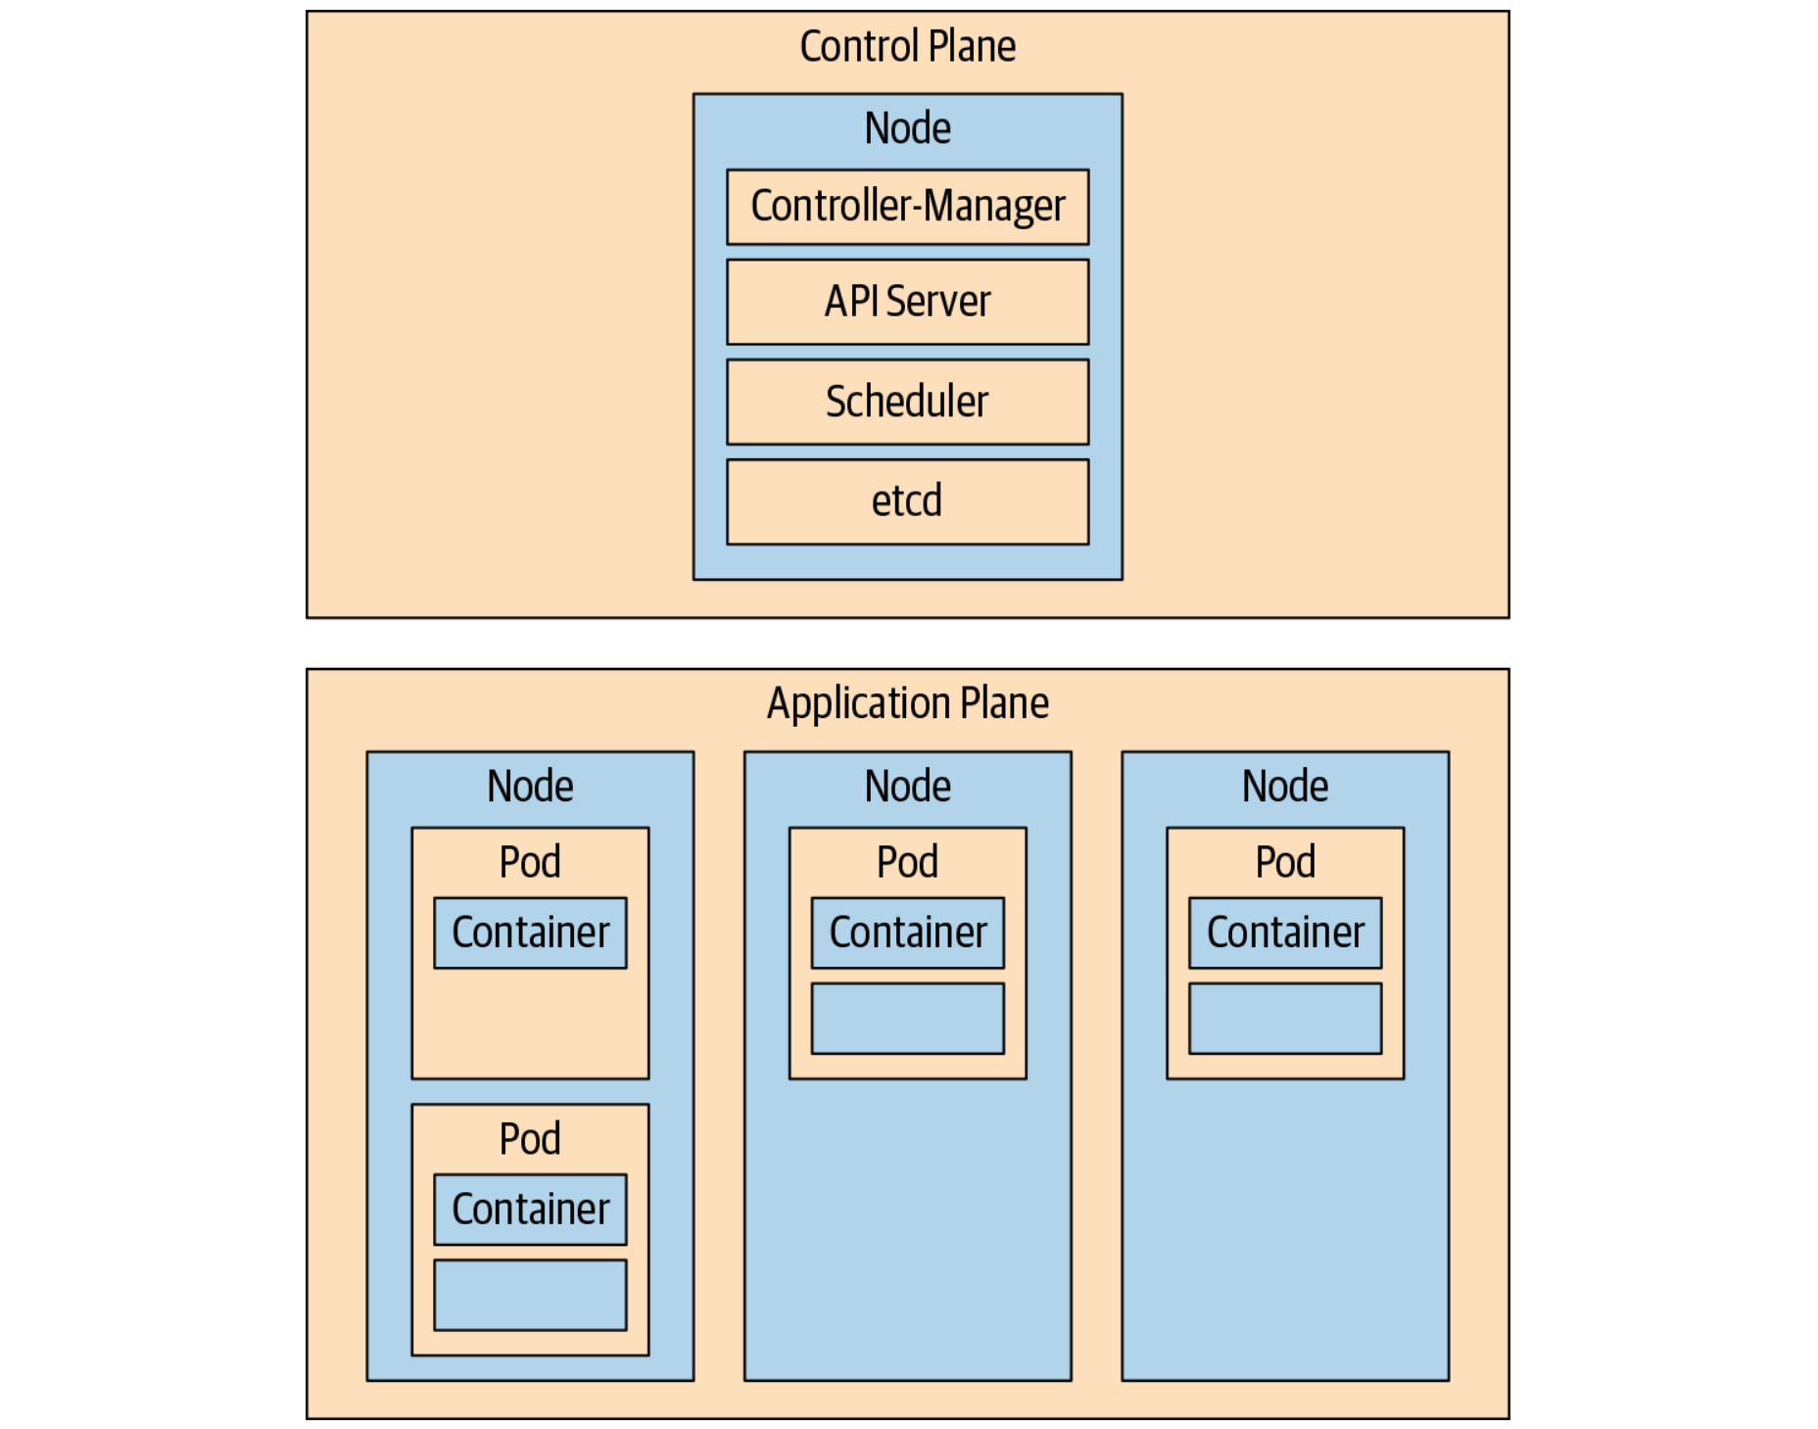

Slide 8
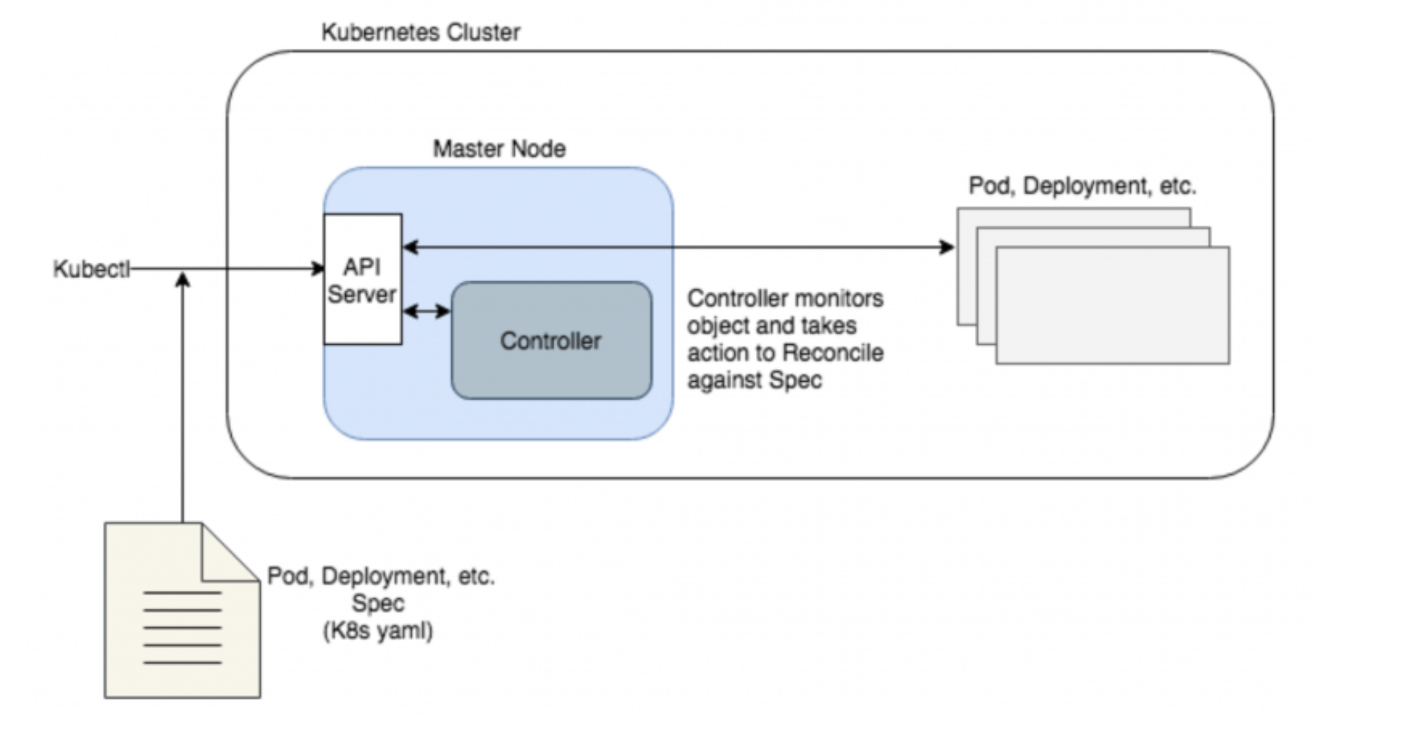

Slide 9
什么是Operator？
通过这种方式，Kubernetes非常适合维护无状态应用。但它本身的资源类型（Pod，Deployments，Namespaces，Services，DaemonSets等）比较有限。虽然每种资源类型都预定了行为及协调方式，但它们的处理方式没有多大差别。
现在，如果您的应用更复杂并需要执行自定义操作以达到期望的运行状态，应该怎么办？
假如一个数据库应用运行在多个节点上。如果超过半数的节点出现故障，则需要按照特定步骤从特定快照中加载数据。使用原生Kubernetes对象类型和controller则难以实现。或者为有状态应用程序扩展节点，升级到新版本或灾难恢复。这些类型的操作通常需要非常具体的步骤，并且通常需要手动干预。

Slide 10
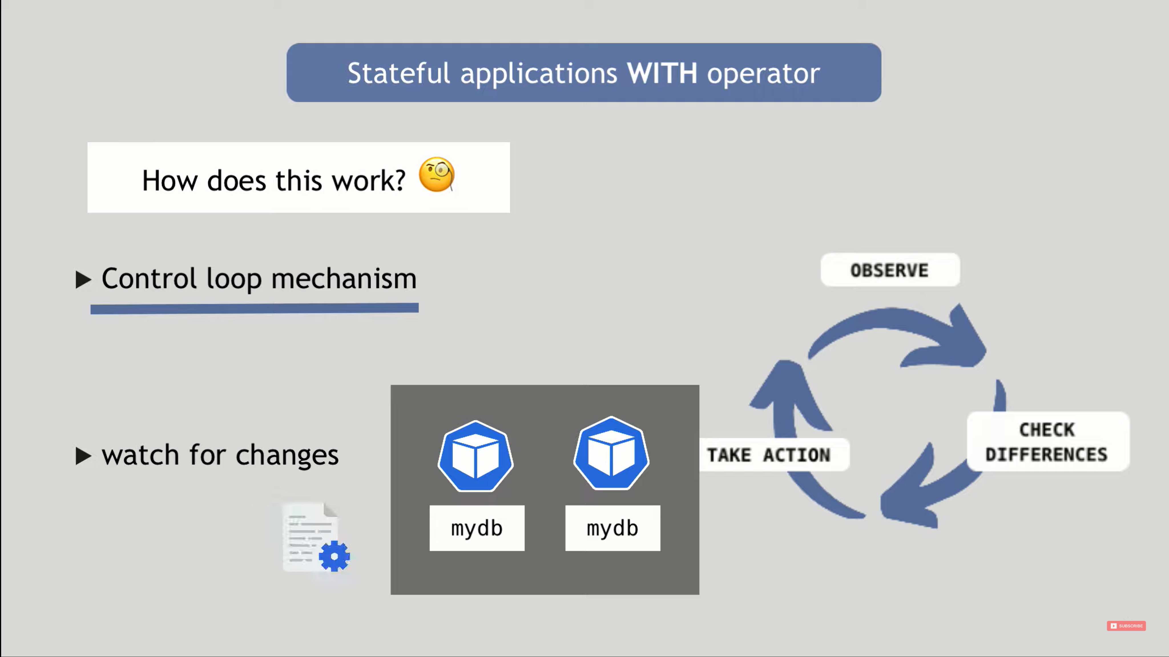

Slide 11
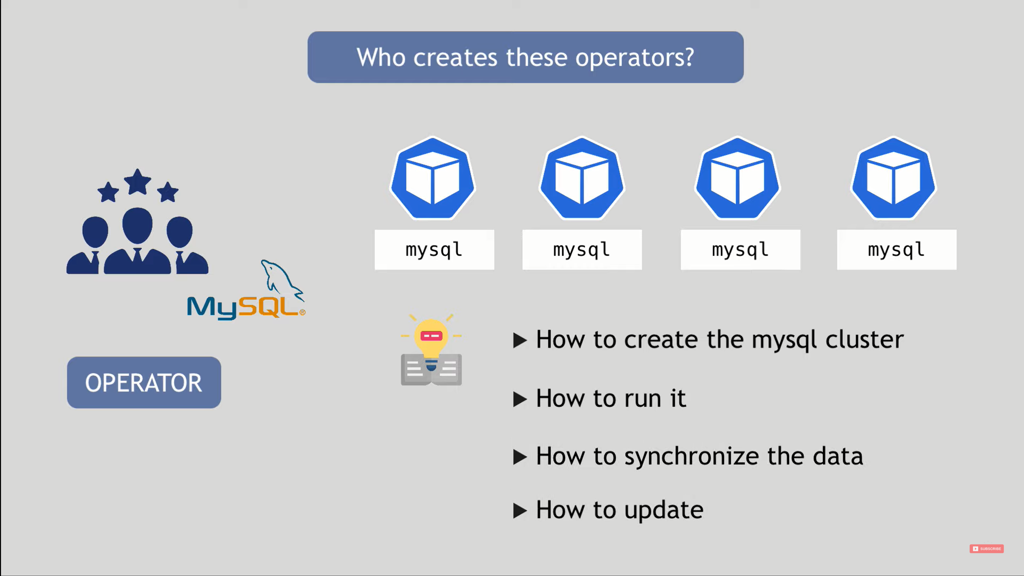

Slide 12
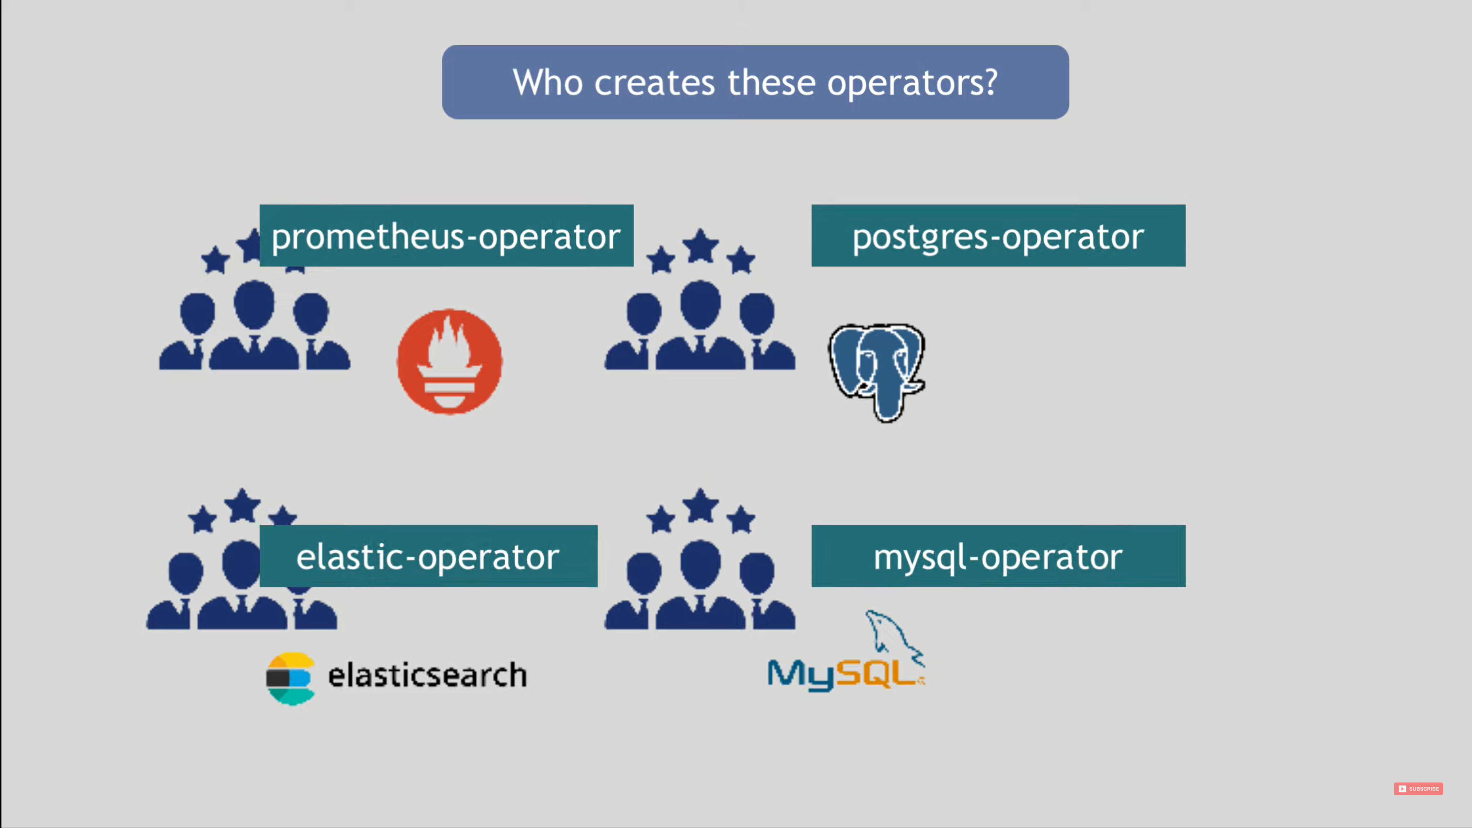

Slide 13
Operator
Operator通过扩展Kubernetes定义Custom Controller，观察应用并根据实际状态执行自定义任务。
应用被定义为Kubernetes对象：Custom Resource （CR），它包含yaml spec和被API服务接受对象类型（K8s kind）。这样，您可以在自定义规范中定义要观察的任何特定条件，并在实例与规范不匹配时协调实例。虽然Operator controller主要使用自定义组件，但它与原生Kubernetes controller协调方式非常类似。

Slide 14
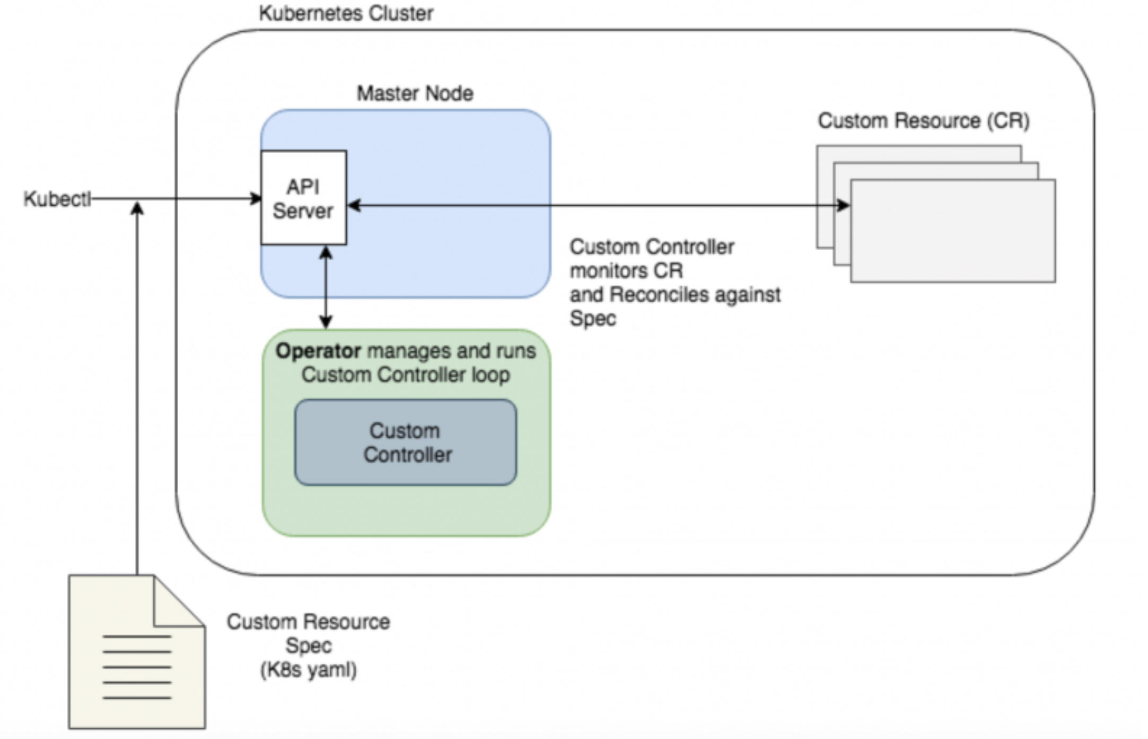
Operator通过Custom Controller协调应用spec。
虽然API服务知道Custom Controller，
但Operator可以独立运行在集群内部或外部。

Slide 15
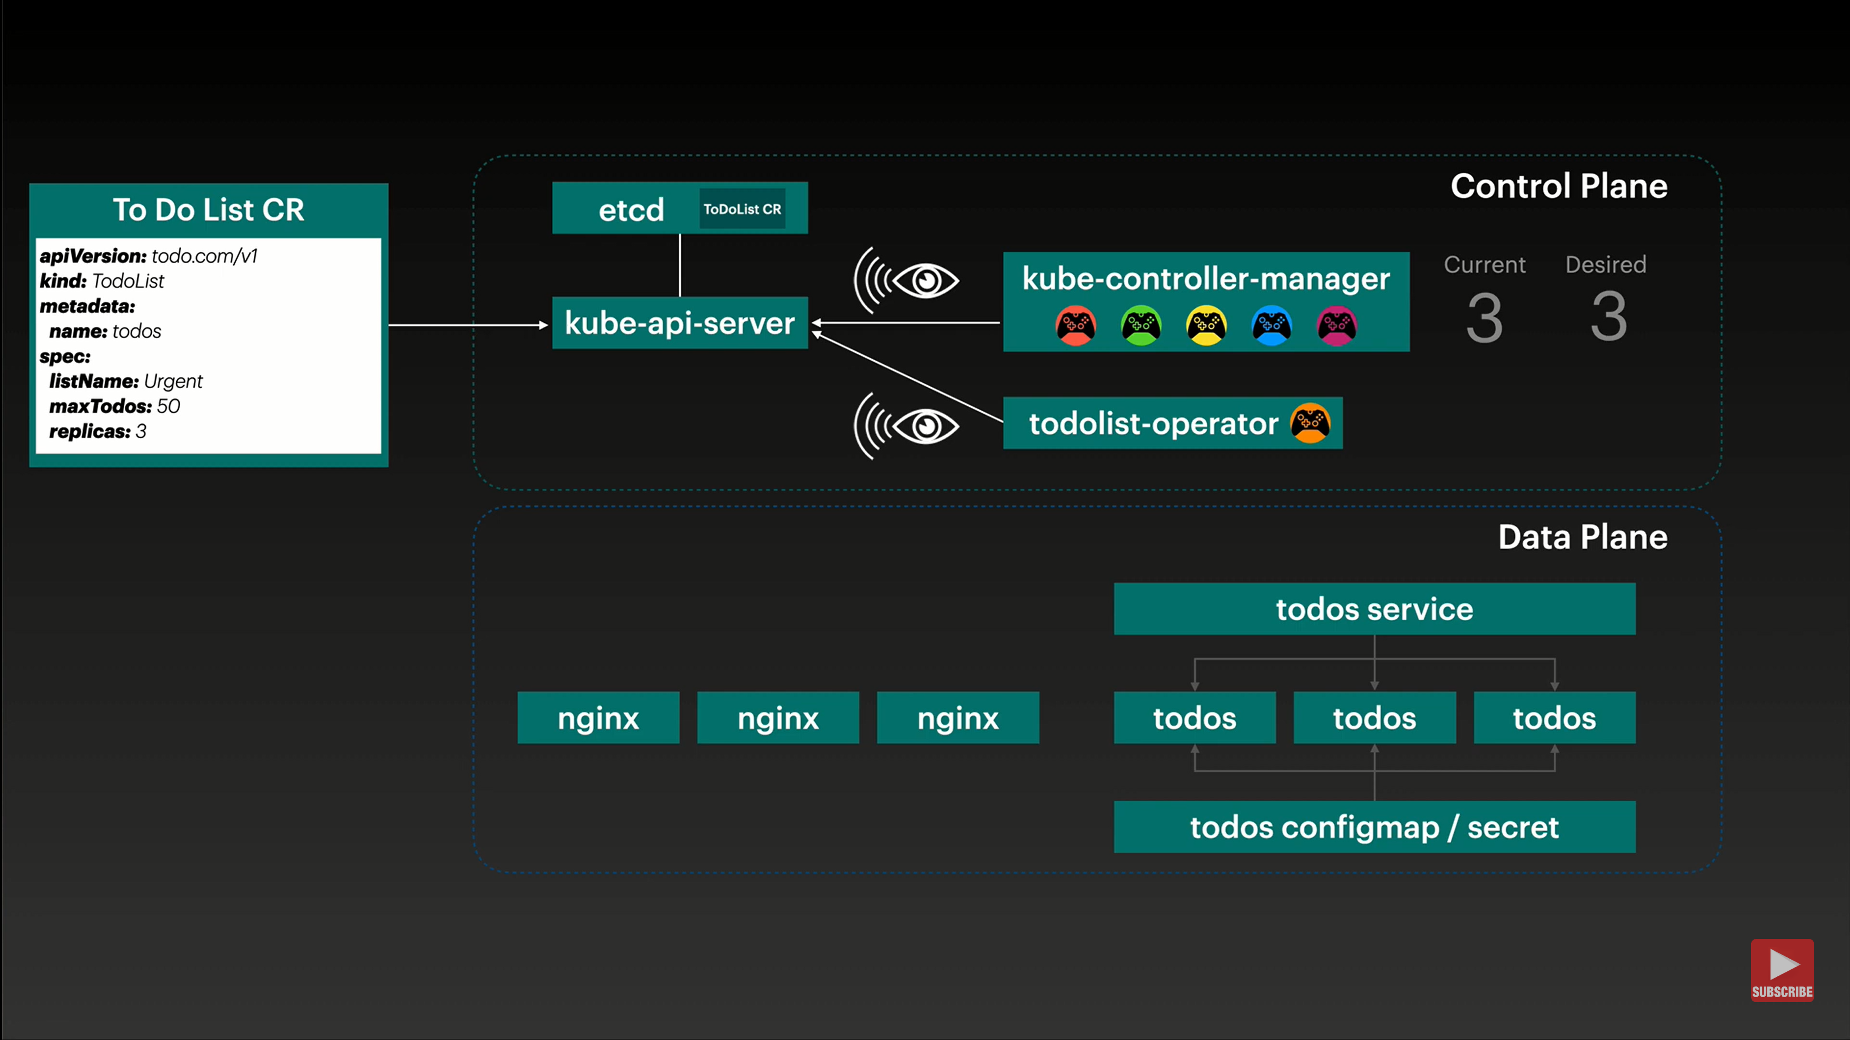

Slide 16
Custom Resource
定制资源（Custom Resource） 是对 Kubernetes API 的扩展。
资源（Resource） 是 Kubernetes API 中的一个端点， 其中存储的是某个类别的 API 对象 的一个集合。 例如内置的 pods 资源包含一组 Pod 对象。
定制资源（Custom Resource） 是对 Kubernetes API 的扩展，不一定在默认的 Kubernetes 安装中就可用。定制资源所代表的是对特定 Kubernetes 安装的一种定制。 不过，很多 Kubernetes 核心功能现在都用定制资源来实现，这使得 Kubernetes 更加模块化。
定制资源可以通过动态注册的方式在运行中的集群内或出现或消失，集群管理员可以独立于集群 更新定制资源。一旦某定制资源被安装，用户可以使用 kubectl 来创建和访问其中的对象，就像他们为 pods 这种内置资源所做的一样。

Slide 17
Custom Controller
就定制资源本身而言，它只能用来存取结构化的数据。 当你将定制资源与 定制控制器（Custom Controller） 相结合时，定制资源就能够 提供真正的 声明式 API（Declarative API）。
使用声明式 API， 你可以声明或者设定你的资源的期望状态，并尝试让 Kubernetes 对象的当前状态 同步到其期望状态。控制器负责将结构化的数据解释为用户所期望状态的记录，并 持续地维护该状态。
你可以在一个运行中的集群上部署和更新定制控制器，这类操作与集群的生命周期无关。 定制控制器可以用于任何类别的资源，不过它们与定制资源结合起来时最为有效。 Operator 模式就是将定制资源 与定制控制器相结合的。你可以使用定制控制器来将特定于某应用的领域知识组织 起来，以编码的形式构造对 Kubernetes API 的扩展。

Slide 18
应使用Custom Resource的条件
你希望使用 Kubernetes 客户端库和 CLI 来创建和更改新的资源。
你希望 kubectl 能够直接支持你的资源
kubectl get my-object object-name
你希望构造新的自动化机制，监测新对象上的更新事件，并对其他对象执行 CRUD 操作，或者监测后者更新前者。
你希望编写自动化组件来处理对对象的更新。
你希望使用 Kubernetes API 对诸如 .spec、.status 和 .metadata 等字段的约定。
你希望对象是对一组受控资源的抽象，或者对其他资源的归纳提炼。

Slide 19
Custom Resource Definitions
CustomResourceDefinition （CRD）API 资源允许你定义定制资源。 定义 CRD 对象的操作会使用你所设定的名字和模式定义（Schema）创建一个新的定制资源， Kubernetes API 负责为你的定制资源提供存储和访问服务。 CRD 对象的名称必须是合法的 DNS 子域名。
CRD 使得你不必编写自己的 API 服务器来处理定制资源，不过其背后实现的通用性也意味着 你所获得的灵活性要比 API 服务器聚合少很多。

Slide 20
创建 CustomResourceDefinition
当你创建新的 CustomResourceDefinition（CRD）时，Kubernetes API 服务器会为你所 指定的每一个版本生成一个 RESTful 的 资源路径。
CRD 可以是名字空间作用域的，也可以 是集群作用域的，取决于 CRD 的 scope 字段设置。和其他现有的内置对象一样，删除 一个名字空间时，该名字空间下的所有定制对象也会被删除。
CRD 本身是不受名字空间限制的，对所有名字空间可用。

Slide 21
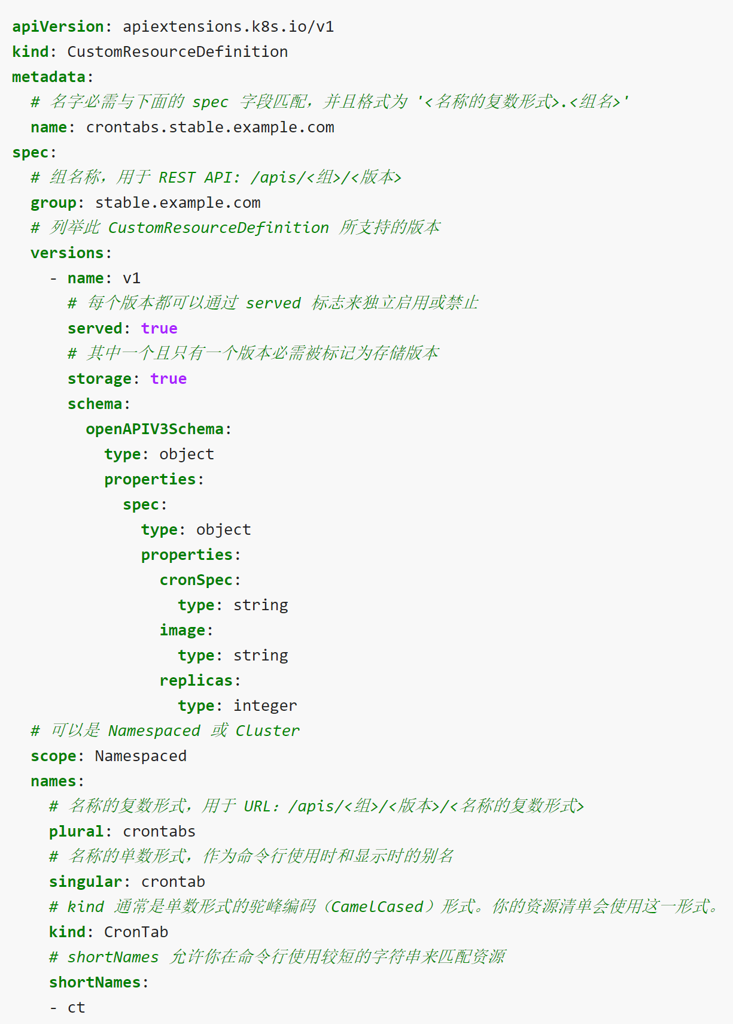
创建 CRD
kubectl apply -f resourcedefinition.yaml
这样一个新的受名字空间约束的 RESTful API 端点会被创建在：
/apis/stable.example.com/v1/namespaces/*/crontabs/...
此端点 URL 自此可以用来创建和管理定制对象。对象的 kind 将是来自你上面创建时 所用的 spec 中指定的 CronTab。

Slide 22
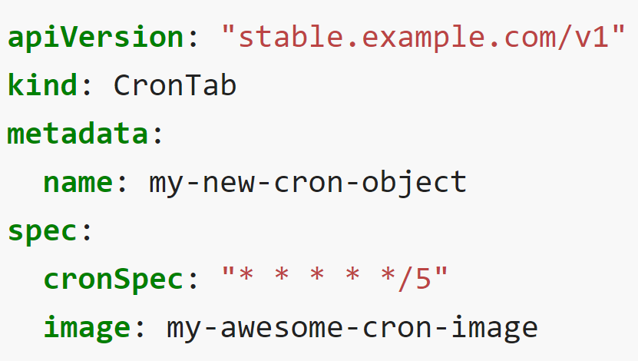
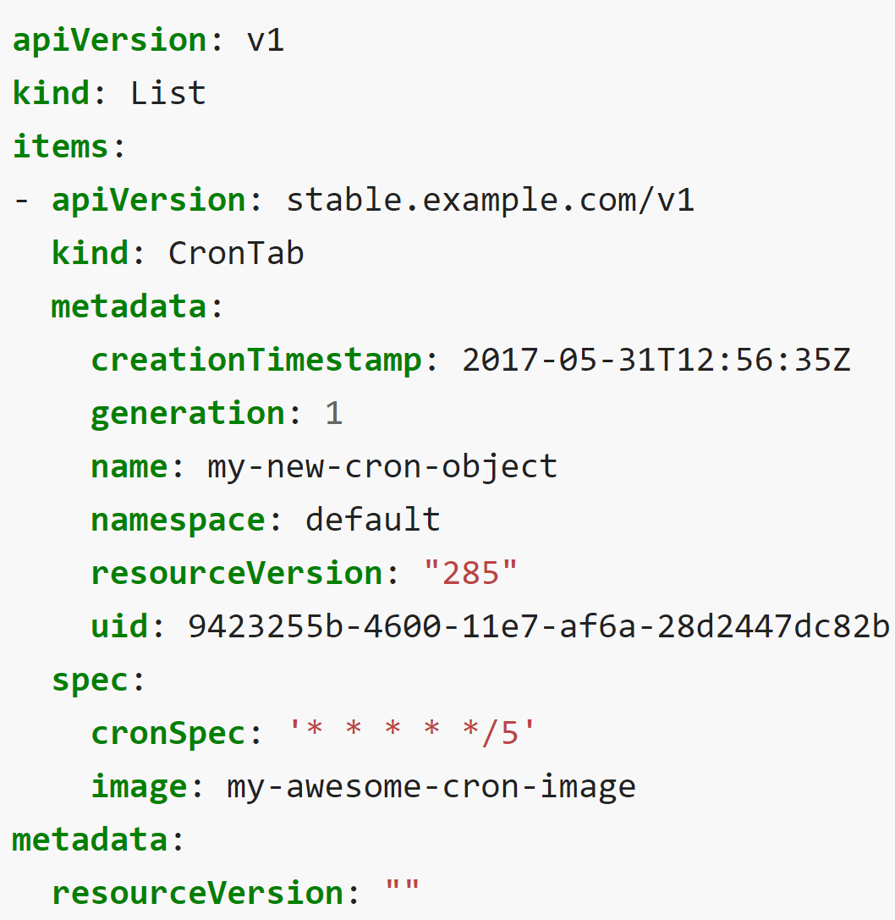
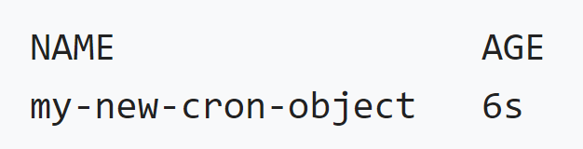
创建定制对象Custom Objects
定制对象可以包含定制字段。这些字段可以包含任意的 JSON 数据。 在下面的例子中，在类别为 CrontTab 的定制对象中，设置了cronSpec 和 image 定制字段。类别 CronTab 来自你在上面所创建的 CRD 的规约。
kubectl apply -f my-crontab.yaml
你就可以使用 kubectl 来管理你的 CronTab 对象了。例如：
kubectl get crontab
大小写不敏感，单数或复数，短名称皆可使用
kubectl get ct -o yaml

Slide 23
删除 CRD
当你删除某 CustomResourceDefinition 时，服务器会卸载其 RESTful API 端点，并删除服务器上存储的所有CustomResource。
kubectl delete -f resourcedefinition.yaml

Slide 24
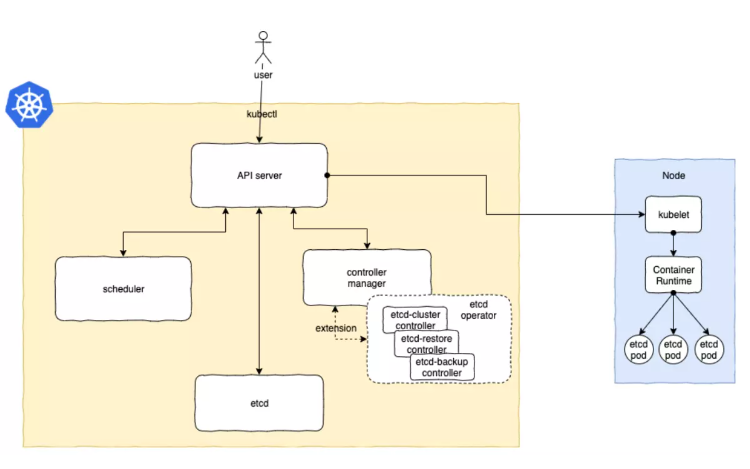

Slide 25
etcd Operator
Fetch the etcd Operator Manifests (Helm install)
$ kubectl create -f etcd-operator-crd.yaml
$ kubectl get crd
NAME CREATED AT
etcdclusters.etcd.database.coreos.com 2019-11-15T02:50:14Z

Slide 26
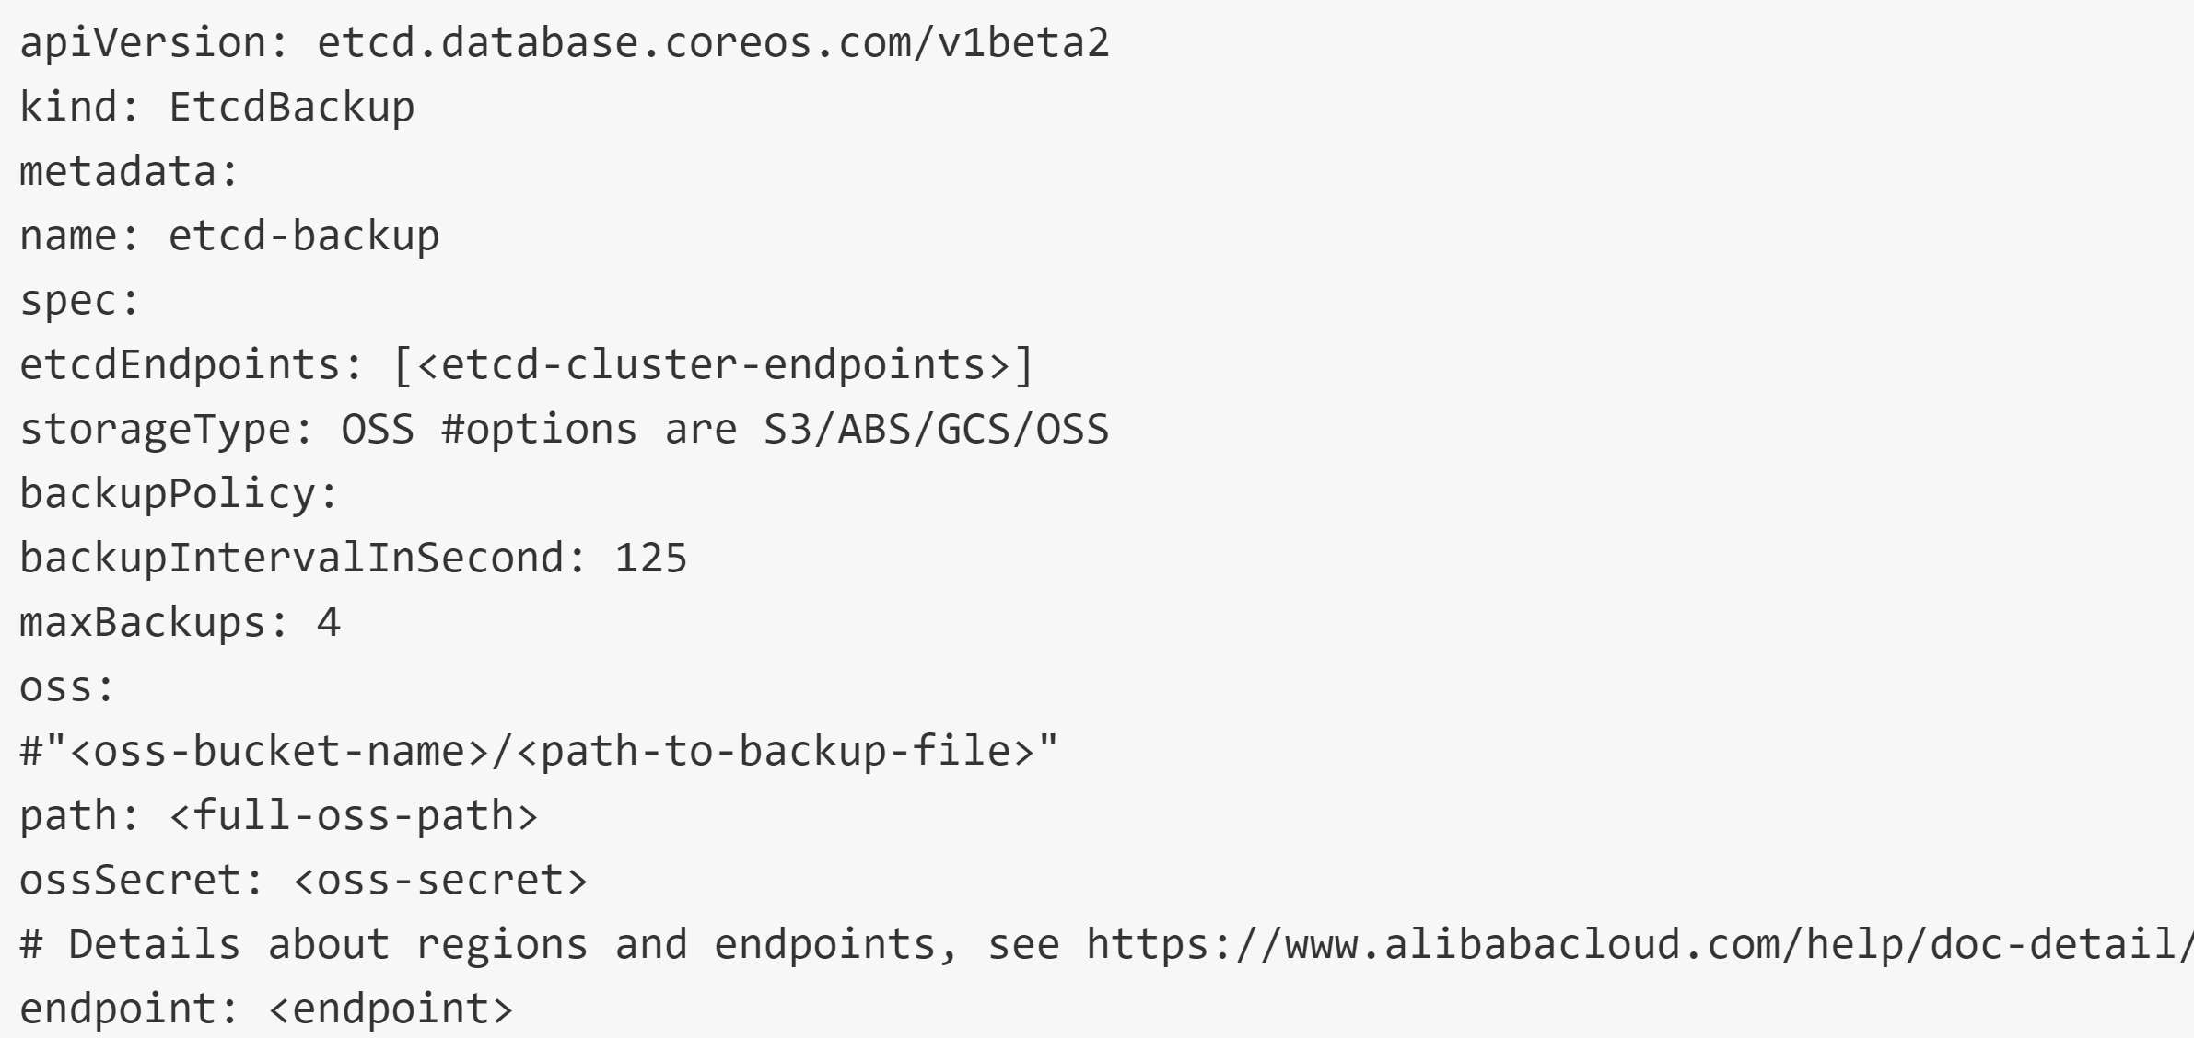
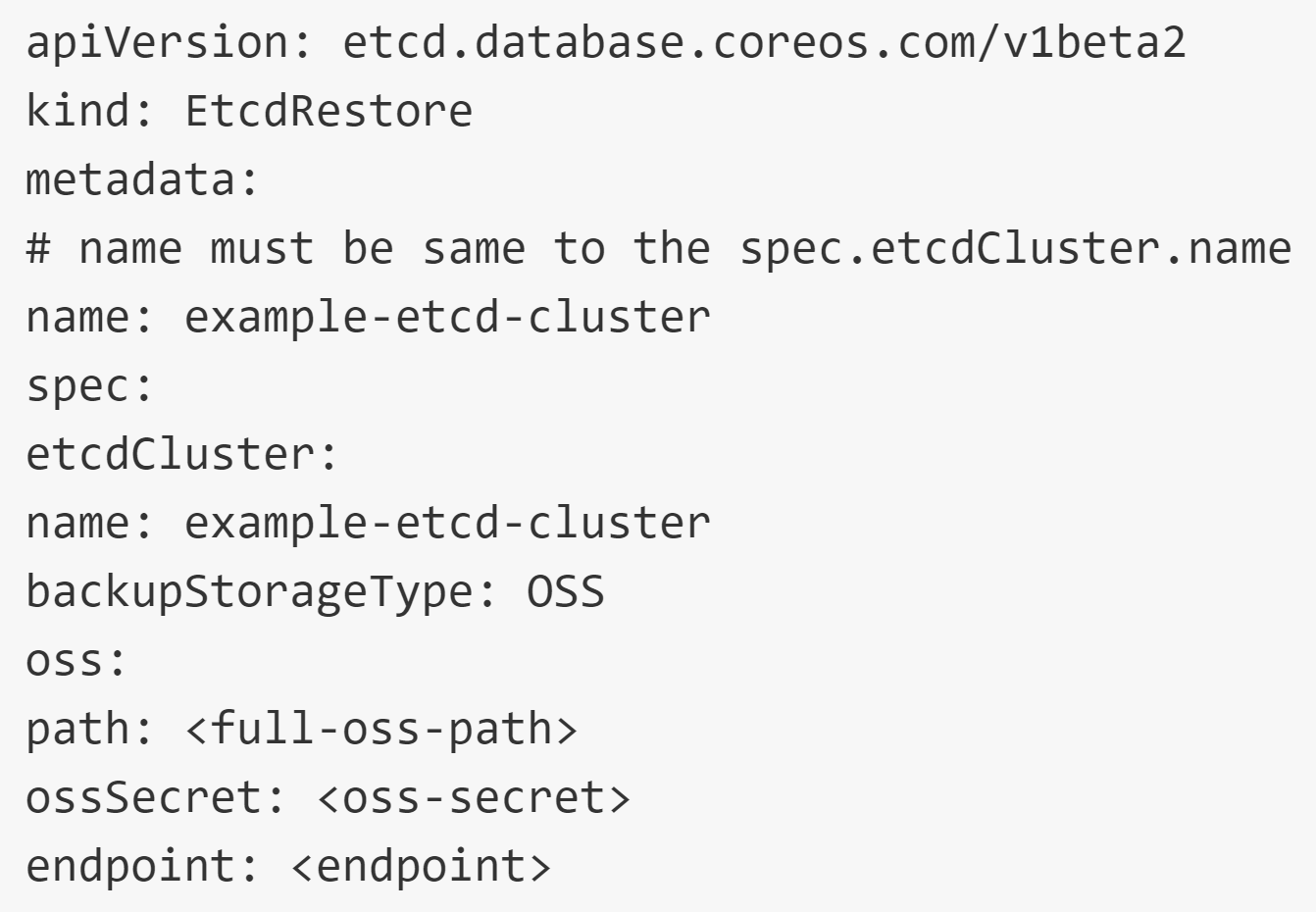

Slide 27
etcd Operator
$ kubectl create -f etcd-operator-sa.yaml
$ kubectl get serviceaccounts
NAME SECRETS AGE
builder 2 2h
default 3 2h
deployer 2 2h
etcd-operator-sa 2 3s
[...]
$ kubectl create -f etcd-operator-role.yaml
$ kubectl create -f etcd-operator-rolebinding.yaml

Slide 28
etcd Operator
$ kubectl create -f etcd-operator-deployment.yaml
deployment.apps/etcd-operator created
$ kubectl get deployments
NAME DESIRED CURRENT UP-TO-DATE AVAILABLE AGE
etcd-operator 1 1 1 1 19s
$ kubectl get pods
NAME READY STATUS RESTARTS AGE
etcd-operator-594fbd565f-4fm8k 0/1 ContainerCreating 0 4s

Slide 29
etcd Operator
Declare an etcd Cluster with your desired state:
$ kubectl create -f etcd-cluster-cr.yaml
etcdcluster.etcd.database.coreos.com/example-etcd-cluster created
$ kubectl get pods -w
NAME READY STATUS RESTARTS AGE
etcd-operator-594fbd565f-4fm8k 1/1 Running 0 3m
example-etcd-cluster-95gqrthjbz 1/1 Running 2 38s
example-etcd-cluster-m9ftnsk572 1/1 Running 0 34s
example-etcd-cluster-pjqhm8d4qj 1/1 Running 0 31s
$ kubectl get services --selector etcd_cluster=example-etcd-cluster
NAME TYPE CLUSTER-IP ... PORT(S) AGE
example-etcd-cluster ClusterIP None ... 2379/TCP,2380/TCP 21h
example-etcd-cluster-client ClusterIP 10.96.46.231 ... 2379/TCP 21h

Slide 30
etcd Operator
Scaling the etcd Cluster:
$ kubectl apply -f etcd-cluster-cr.yaml
Recovering from a failed etcd member:
$ kubectl delete pod example-etcd-cluster-95gqrthjbz
Upgrading etcd Clusters:
$ kubectl get pod example-etcd-cluster-795649v9kq -o yaml | grep "image:" | uniq
image: quay.io/coreos/etcd:v3.1.10
image: busybox:1.28.0-glibc
Edit etcd-cluster-cr.yaml and change the version spec from 3.1.10 to 3.2.13.
$ kubectl apply -f etcd-cluster-cr.yaml
$ kubectl patch etcdcluster example-etcd-cluster --type='json' \
-p '[{"op": "replace", "path": "/spec/version", "value":3.3.12}]'

Slide 31
etcd Operator
Clean up:
$ kubectl delete -f etcd-operator-sa.yaml
$ kubectl delete -f etcd-operator-role.yaml
$ kubectl delete -f etcd-operator-rolebinding.yaml
$ kubectl delete -f etcd-operator-crd.yaml
$ kubectl delete -f etcd-operator-deployment.yaml
$ kubectl delete -f etcd-cluster-cr.yaml

Slide 32
Operator Scopes
Operator can be limited to a namespace, or it can maintain its operand across an entire cluster.
Scope: Namespaced Cluster
Role ClusterRole
RoleBinding ClusterRoleBinding

Slide 33
Authorization
Authorization—the power to do things on the cluster through the API—is defined in Kubernetes by one of a few available access control systems.
Role-Based Access Control (RBAC) is the preferred and most tightly integrated of these.
RBAC regulates access to system resources according to the Role a system user performs. A Role is a set of capabilities to take certain actions on particular API resources, such as create, read, update, or delete. The capabilities described by a Role are granted, or bound, to a user by a RoleBinding.

Slide 34
ClusterRoles and ClusterRoleBindings
Roles and RoleBindings are also restricted to a namespace.
ClusterRoles and ClusterRoleBindings are their cluster-wide equivalents.
A standard, namespaced RoleBinding can reference only roles in its namespace, or ClusterRoles defined for the entire cluster.
When a RoleBinding references a ClusterRole, the rules declared in the ClusterRole apply to only those specified resources in the binding’s own namespace. In this way, a set of common roles can be defined once as ClusterRoles, but reused and granted to users in just a given namespace.

Slide 35
Operator Framework
Operator Framework 同样也是 CoreOS 开源的一个用于快速开发 Operator 的工具包，该框架包含两个主要的部分：
Operator SDK: 无需了解复杂的 Kubernetes API 特性，即可让你根据你自己的专业知识构建一个 Operator 应用。
Operator Lifecycle Manager (OLM): 帮助你安装、更新和管理跨集群的运行中的所有 Operator（以及他们的相关服务）

Slide 36
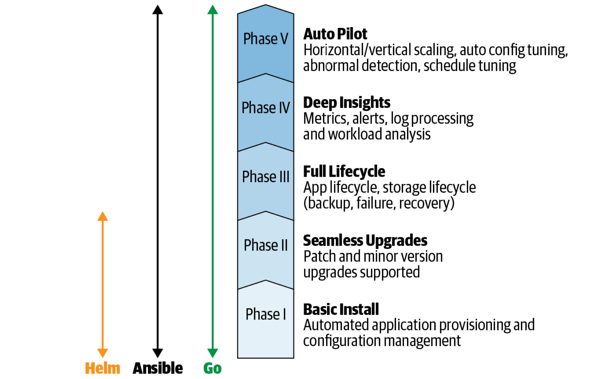
Operator Maturity Model

Slide 37
Operator SDK
The Operator SDK is a set of tools for scaffolding, building, and preparing an Operator for deployment.
Operator SDK 提供以下工作流来开发一个新的 Operator：
1. 使用 SDK 创建一个新的 Operator 项目
2. 通过添加自定义资源（CRD）定义新的资源 API
3. 指定使用 SDK API 来 watch 的资源
4. 定义 Operator 的协调（reconcile）逻辑
5. 使用 Operator SDK 构建并生成 Operator 部署清单文件

Slide 38
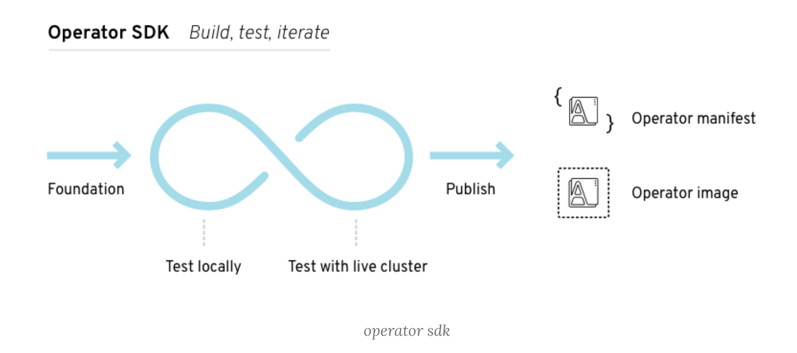

Slide 39
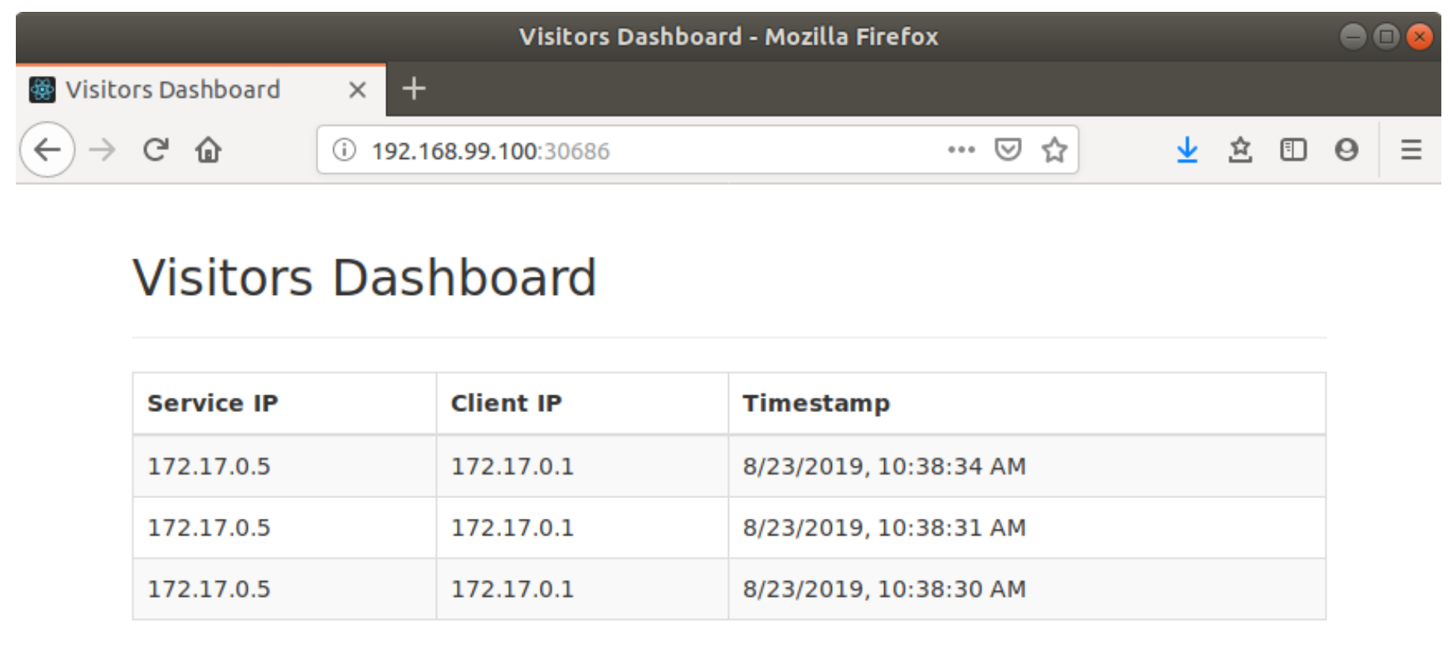
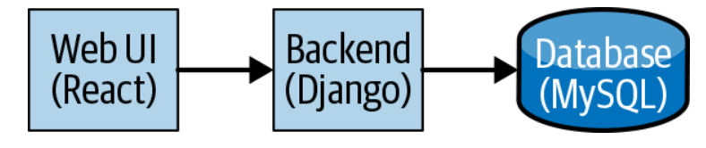
Visitors Site

Slide 40
Adapter Operators
$ OPERATOR_NAME=visitors-helm-operator
$ operator-sdk new $OPERATOR_NAME
--api-version=example.com/v1 --kind=VisitorsApp --type=helm
$ wget https://github.com/kubernetes-operators-book/\
chapters/releases/download/1.0.0/visitors-helm.tgz
$ operator-sdk new $OPERATOR_NAME
--api-version=example.com/v1 --kind=VisitorsApp
--type=helm --helm-chart=./visitors-helm.tgz
Defaulted api-version: charts.helm.k8s.io/v1alpha1
Kind name derived from the name of the chart

Slide 41
Adapter Operators
The SDK creates a new directory with the same name as $OPERATOR_NAME, which contains all of the Operator’s files.
deploy/
This directory contains Kubernetes template files that are used to deploy and configure the Operator, including the CRD, the Operator deployment resource itself, and the necessary RBAC resources for the Operator to run.
helm-charts/
This directory contains a skeleton directory structure for a Helm chart with the same name as the CR kind. The files within are similar to those the Helm CLI creates when it initializes a new chart, including a values.yaml file. A new chart is added to this directory for each new CR type the Operator manages.
watches.yaml
This file maps each CR type to the specific Helm chart that is used to handle it.

Slide 42
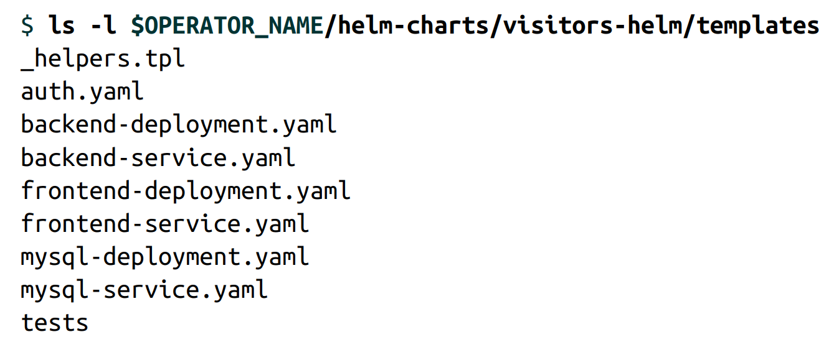
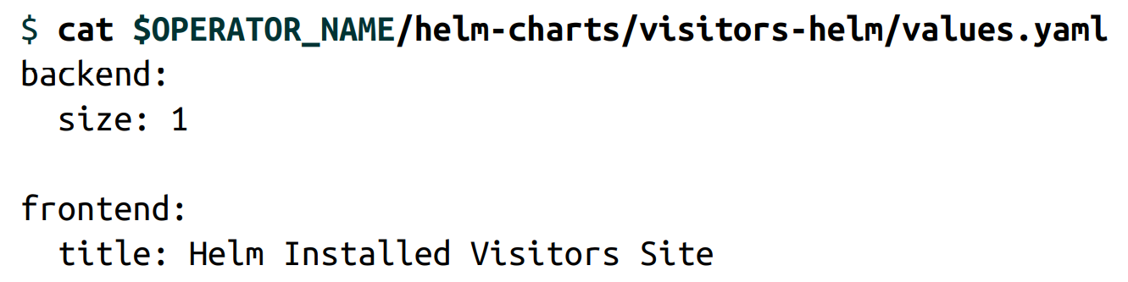
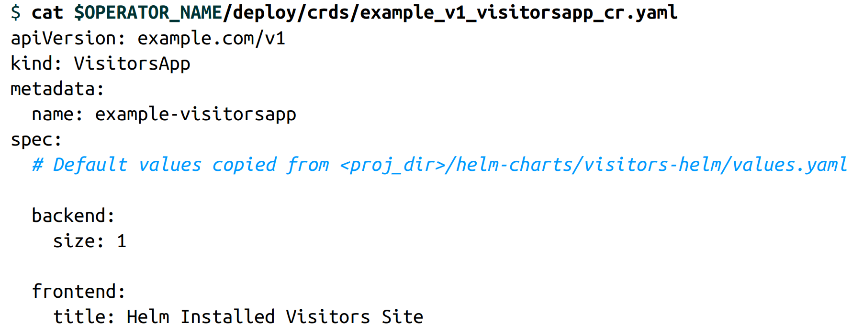

Slide 43
Running the Helm Operator
$ cp watches.yaml local-watches.yaml
$ kubectl apply -f deploy/crds/*_crd.yaml
$ operator-sdk up local --watches-file ./local-watches.yaml

Slide 44
Testing the Operator
Edit the spec section of example_v1_visitorsapp_cr.yaml
$ kubectl apply -f deploy/crds/*_cr.yaml

Slide 45
Operators in Go with the Operator SDK
While the Helm and Ansible Operators can be created quickly and easily, their functionality is ultimately limited by those underlying technologies.

Slide 46
Initializing the Operator
$ OPERATOR_NAME=visitors-operator
$ operator-sdk new $OPERATOR_NAME

Slide 47
Operator Scope
Namespaced (default)
Limits the Operator to managing resources in a single namespace
Cluster
Allows the Operator to manage resources across the entire cluster

Slide 48
Namespaced ==> Cluster
deploy/operator.yaml
WATCH_NAMESPACE: ""
deploy/role.yaml
kind: Role to ClusterRole
deploy/role_binding.yaml
kind: RoleBinding to ClusterRoleBinding.
roleRef: change the kind to ClusterRole.
subjects: add the key namespace with the value being the namespace in which the Operator pod is deployed.
In the spec section of the CRD file, change the scope field to Cluster
In the _types.go file for the CRD, add the tag // +genclient:nonNamespaced above the struct for the CR

Slide 49
Custom Resource Definitions
$ operator-sdk add api --api-version=example.com/v1 --kind=VisitorsApp
deploy/crds/example_v1_visitorsapp-cr.yaml
This is an example CR of the generated type.
deploy/crds/example_v1_visitorsapp_crd.yaml
This file is the beginning of a CRD manifest.
pkg/apis/example/v1/visitorsapp_types.go
This file contains a number of struct objects that the Operator codebase leverages.

Slide 50
Defining the Go Types
The spec object (VisitorsAppSpec): all possible configuration values that may be specified for resources of this type.
The name of the variable as it will be referenced from within the Operator code
The Go type for the variable
The name of the field as it will be specified in the CR
The status object (VisitorsAppStatus): all possible values that the Operator may set to convey the state of the CR.
The name of the variable as it will be referenced from within the Operator code
The Go type for the variable
The name of the field as it will appear in the description of the CR
$ operator-sdk generate k8s

Slide 51
Add Controller
$ operator-sdk add controller
--api-version=example.com/v1 --kind=VisitorsApp
/pkg/controller/visitorsapp/visitorsapp_controller.go

Slide 52
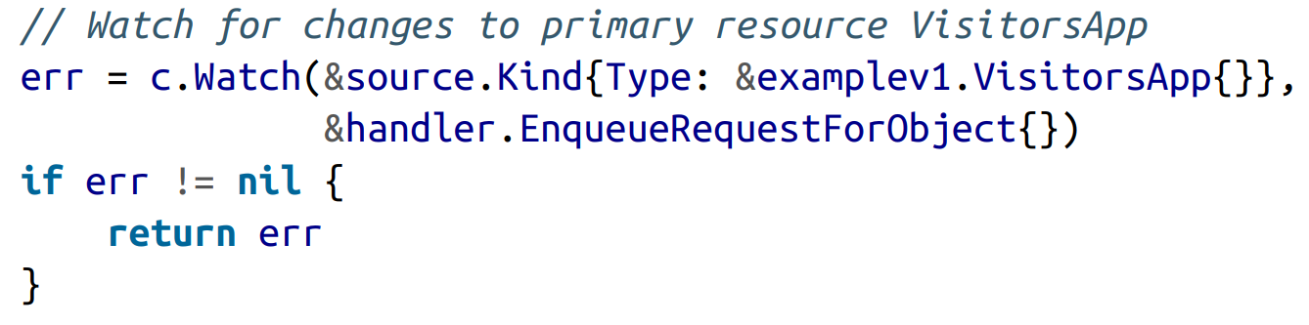
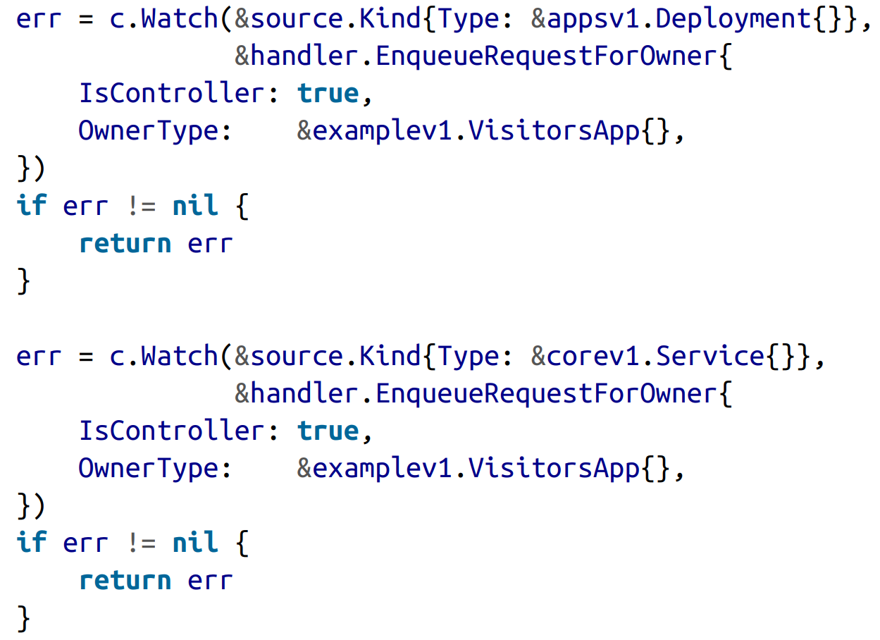
Watches

Slide 53
The Reconcile Function
Purpose: resolve the actual state of the system against the desired state requested by the resource.
return reconcile.Result{}, nil
return reconcile.Result{}, err
return reconcile.Result{Requeue: true}, nil
return reconcile.Result{RequeueAfter: time.Second*5}, nil

Slide 54
Retrieving the Resource
/pkg/controller/visitorsapp/backend.go
.Spec.Size
.Status.BackendImage

Slide 55
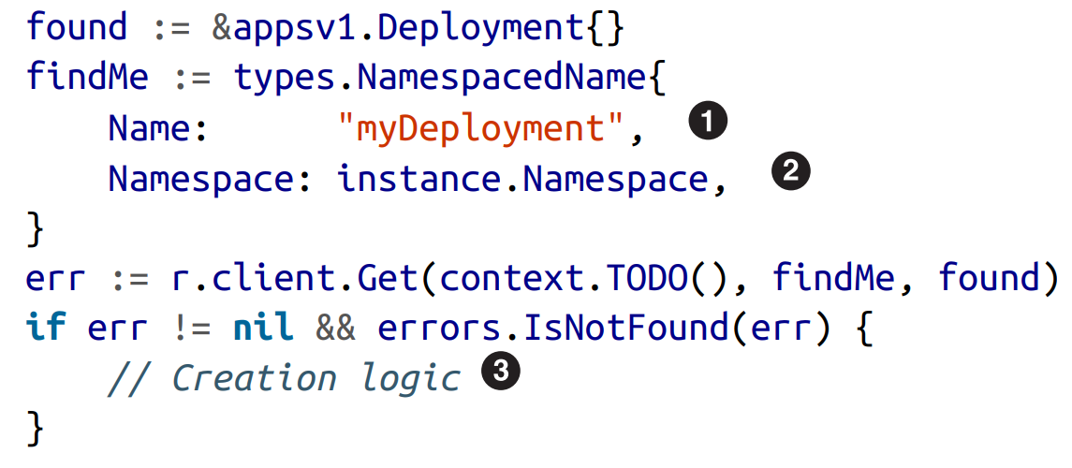
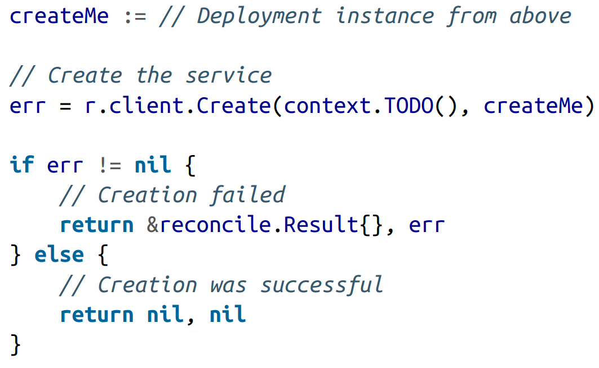
Child Resource Creation
/pkg/controller/visitorsapp/common.go

Slide 56
Child Resource Deletion
In most cases, deleting child resources is significantly simpler than creating them: Kubernetes will do it for you.
If the child resource’s owner type is correctly set to the primary resource, when the parent is deleted, Kubernetes garbage collection will automatically clean up all of its child resources.

Slide 57
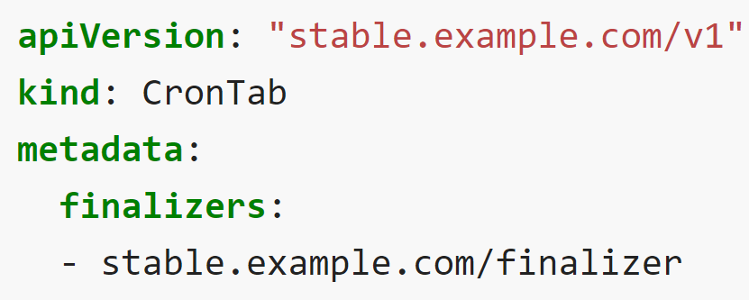
Finalizers
Finalizer 能够让控制器实现异步的删除前（Pre-delete）回调。 与内置对象类似，定制对象也支持 Finalizer。
你可以像下面一样为定制对象添加 Finalizer：
自定义 Finalizer 的标识符包含一个域名、一个正向斜线和 finalizer 的名称。 任何控制器都可以在任何对象的 finalizer 列表中添加新的 finalizer。
对带有 Finalizer 的对象的第一个删除请求会为其 metadata.deletionTimestamp 设置一个值，但不会真的删除对象。一旦此值被设置，finalizers 列表中的表项 只能被移除。在列表中仍然包含 finalizer 时，无法强制删除对应的对象。
当 metadata.deletionTimestamp 字段被设置时，监视该对象的各个控制器会 执行它们所能处理的 finalizer，并在完成处理之后将其从列表中移除。 每个控制器负责将其 finalizer 从列表中删除。metadata.deletionGracePeriodSeconds 的取值控制对更新的轮询周期。
一旦 finalizers 列表为空时，就意味着所有 finalizer 都被执行过， Kubernetes 会最终删除该资源。

Slide 58
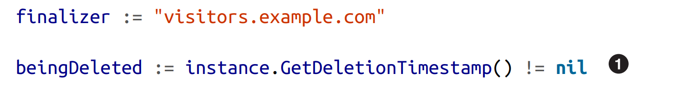
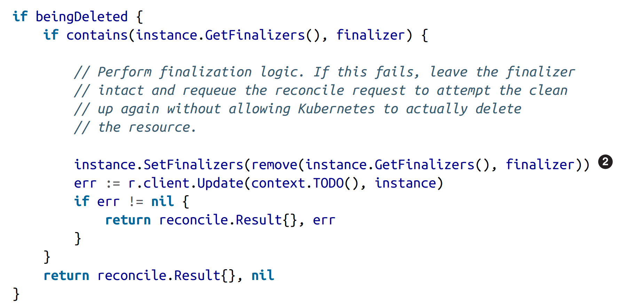

Slide 59
Idempotency
Before creating child resources, check to see if they already exist.
Changes to a resource’s spec (configuration values) trigger the reconcile loop.
A reconciliation request needs to update the CR’s Status field.

Slide 60
Running an Operator Locally
$ kubectl apply -f deploy/crds/*_crd.yaml
$ export OPERATOR_NAME=<operator-name>
$ operator-sdk up local --namespace default
$ kubectl apply -f deploy/crds/*_cr.yaml

Slide 61
Operator Lifecycle Manager
Installation
Management

Slide 62
ClusterServiceVersion
The ClusterServiceVersion (CSV) is the primary metadata resource that describes an Operator. Each CSV represents a version of an Operator and contains the following:
General metadata about the Operator, including its name, version, description, and icon
Operator installation information, describing the deployments that are created and the permissions that are required
The CRDs that are owned by the Operator as well as references to any CRDs the Operator is dependent on
Annotations on the CRD fields to provide hints to users on how to properly specify values for the fields
a deployment describes the ”pod template” for pods
a CSV contains a ”deployment template” for the deployment

Slide 63
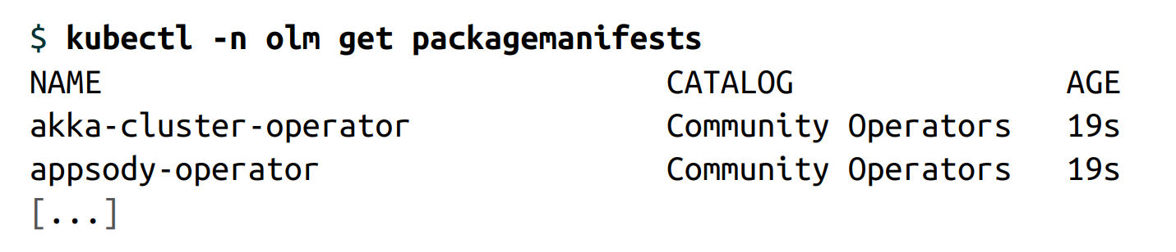
CatalogSource
A CatalogSource contains information for accessing a repository of Operators.

Slide 64
Subscription
End users create a subscription to install, and subsequently update, the Operators that OLM provides.
A subscription is made to a channel, which is a stream of Operator versions.
approval mode (manual/automatic): tells OLM if manual user review is required before an Operator is installed

Slide 65
InstallPlan
A subscription creates an InstallPlan, which describes the full list of resources that OLM will create to satisfy the CSV’s resource requirements.
manual approval

Slide 66
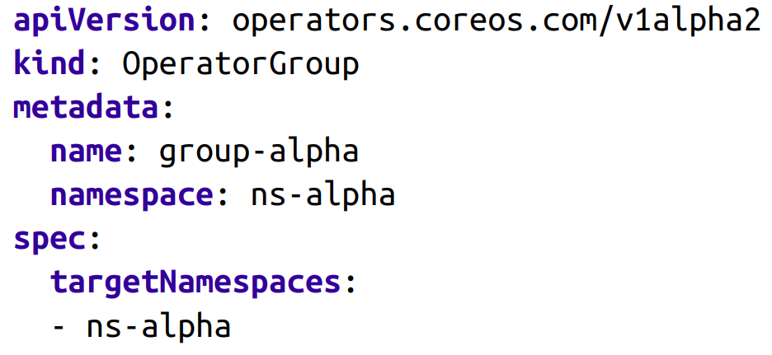
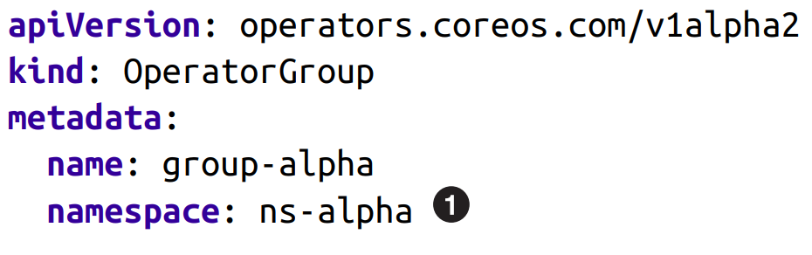
OperatorGroup
These designate namespaces that may be accessed by an individual Operator.
An Operator belonging to an OperatorGroup will not react to custom resource changes in a namespace not indicated by the group.
Although you can use OperatorGroups for fine-grained control for a set of namespaces, they are most commonly used in two ways:
To scope an Operator to a single namespace
To allow an Operator to run globally across all namespaces

Slide 67
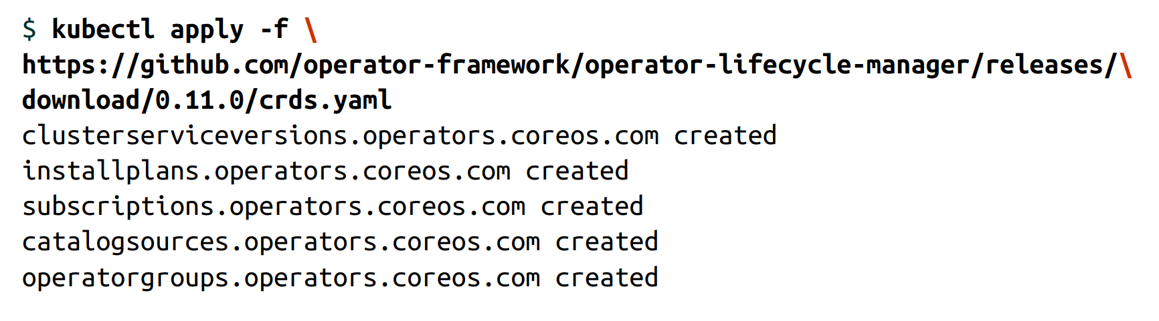
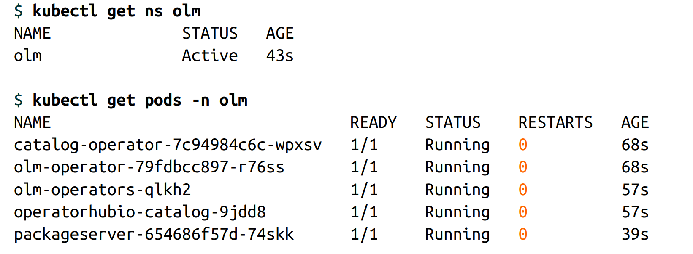
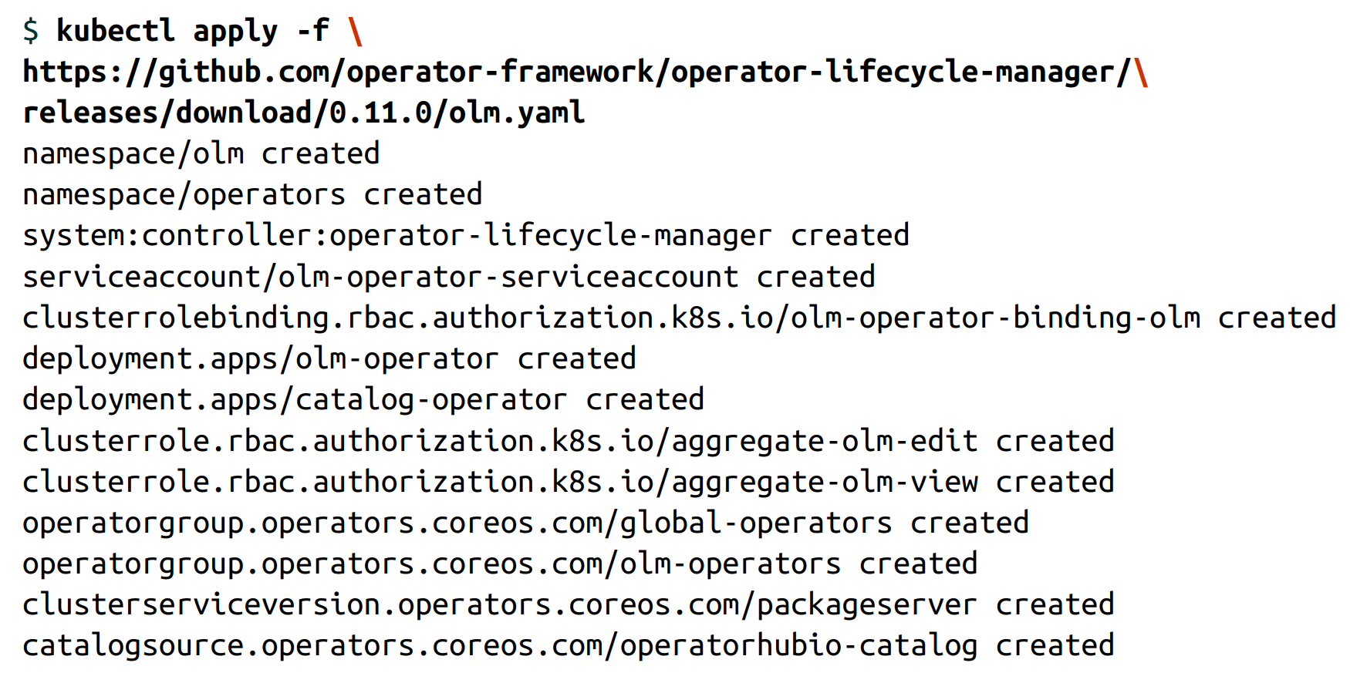
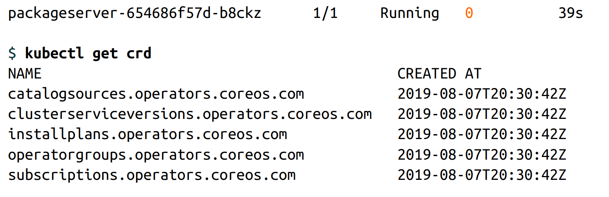
Installing OLM

Slide 68
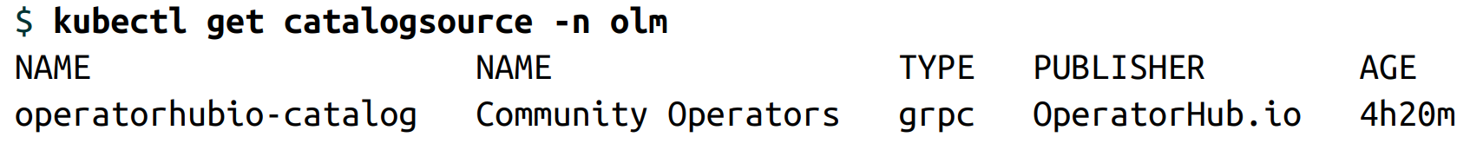
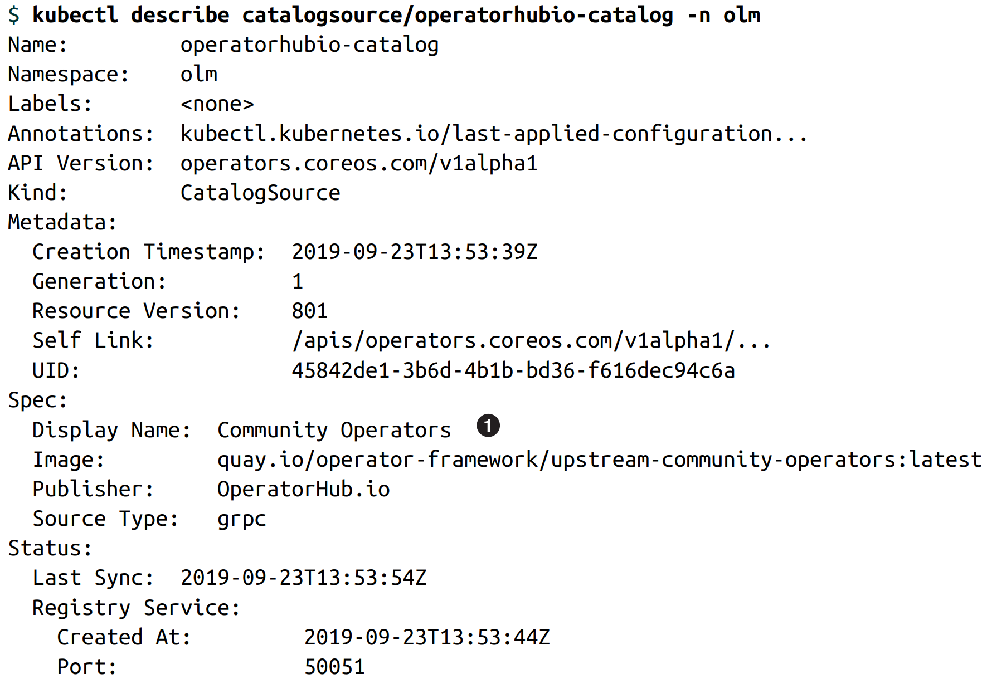
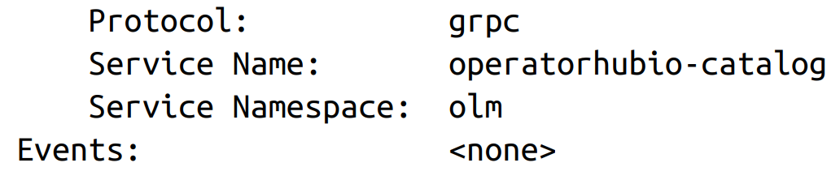
Using OLM

Slide 69
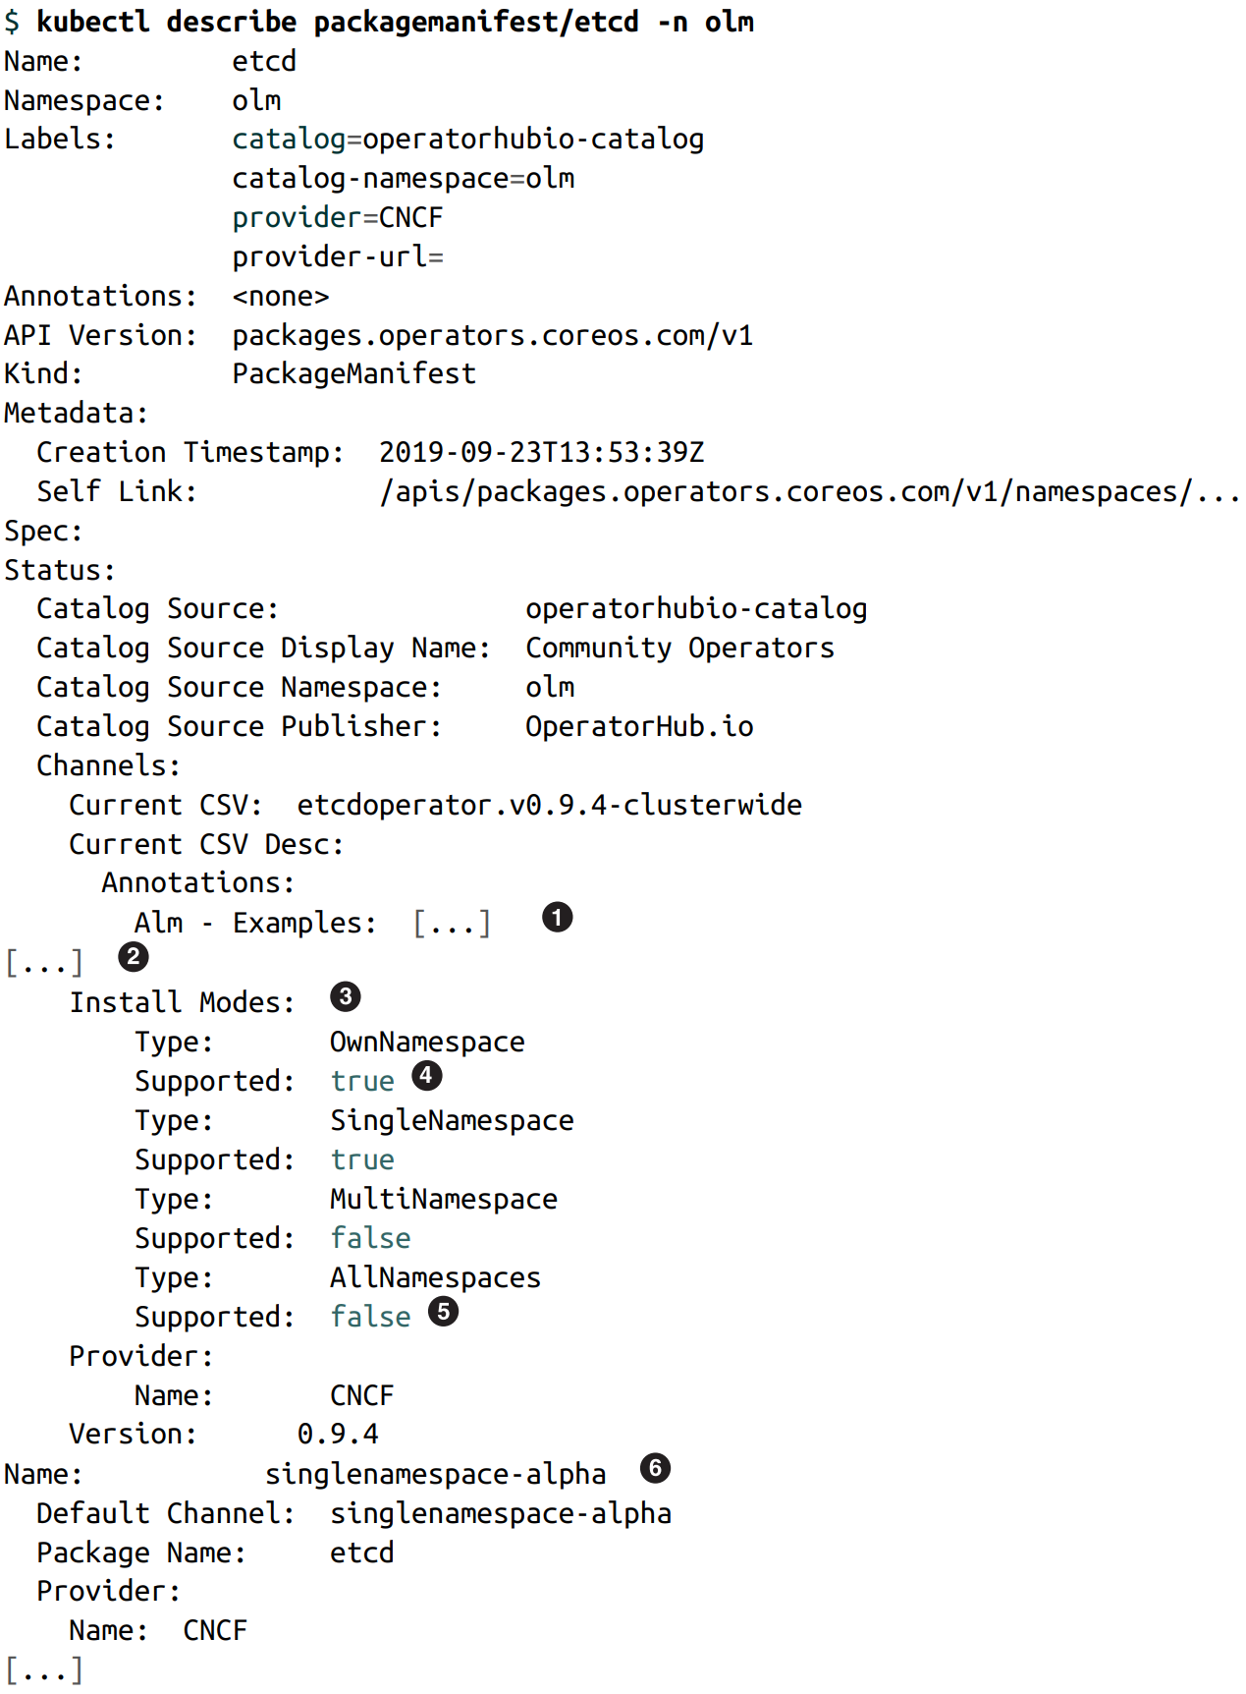
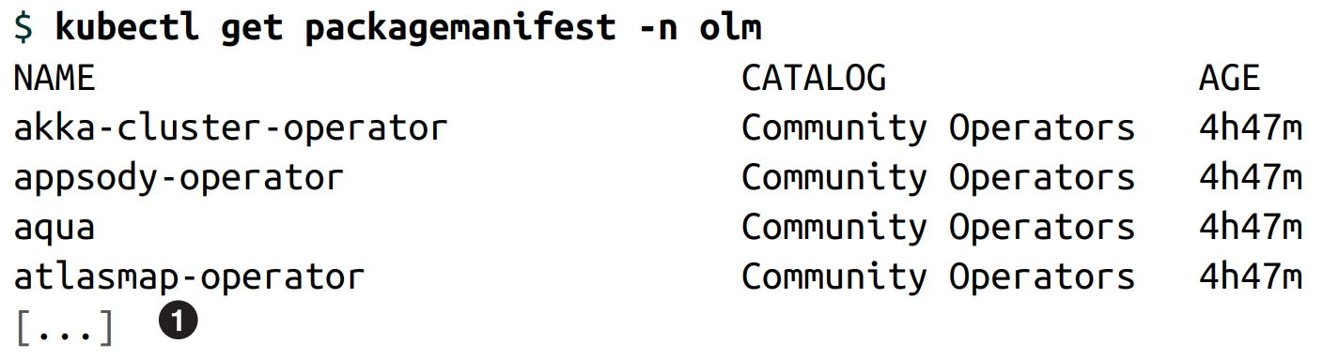
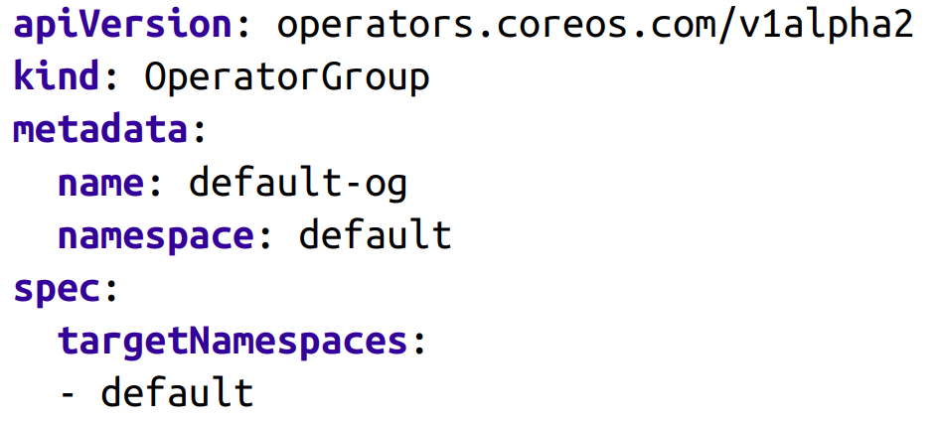
Using OLM

Slide 70
Install Modes
OwnNamespace
The Operator can be deployed to an OperatorGroup that selects its own namespace.
SingleNamespace
The Operator can be deployed to an OperatorGroup that selects one namespace.
MultiNamespace
The Operator can be deployed to an OperatorGroup that selects more than one namespace.
AllNamespaces
The Operator can be deployed to an OperatorGroup that selects all namespaces (defined as targetNamespace: "").

Slide 71
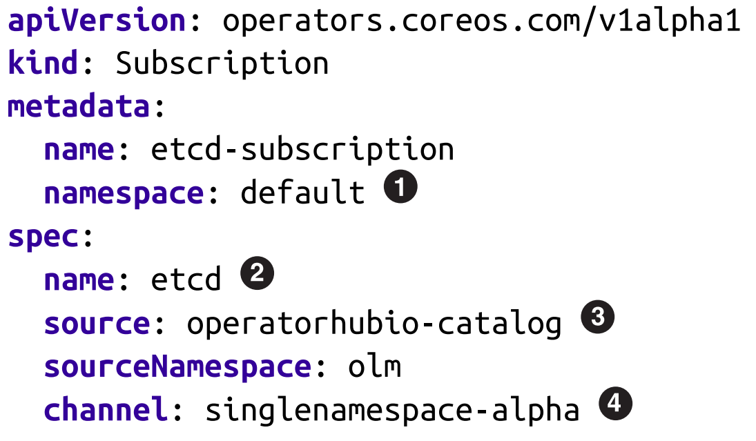
Using OLM

Slide 72
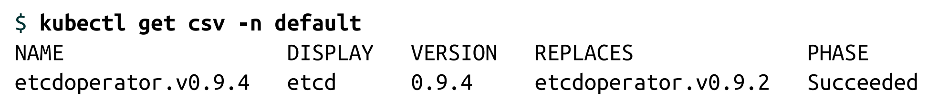
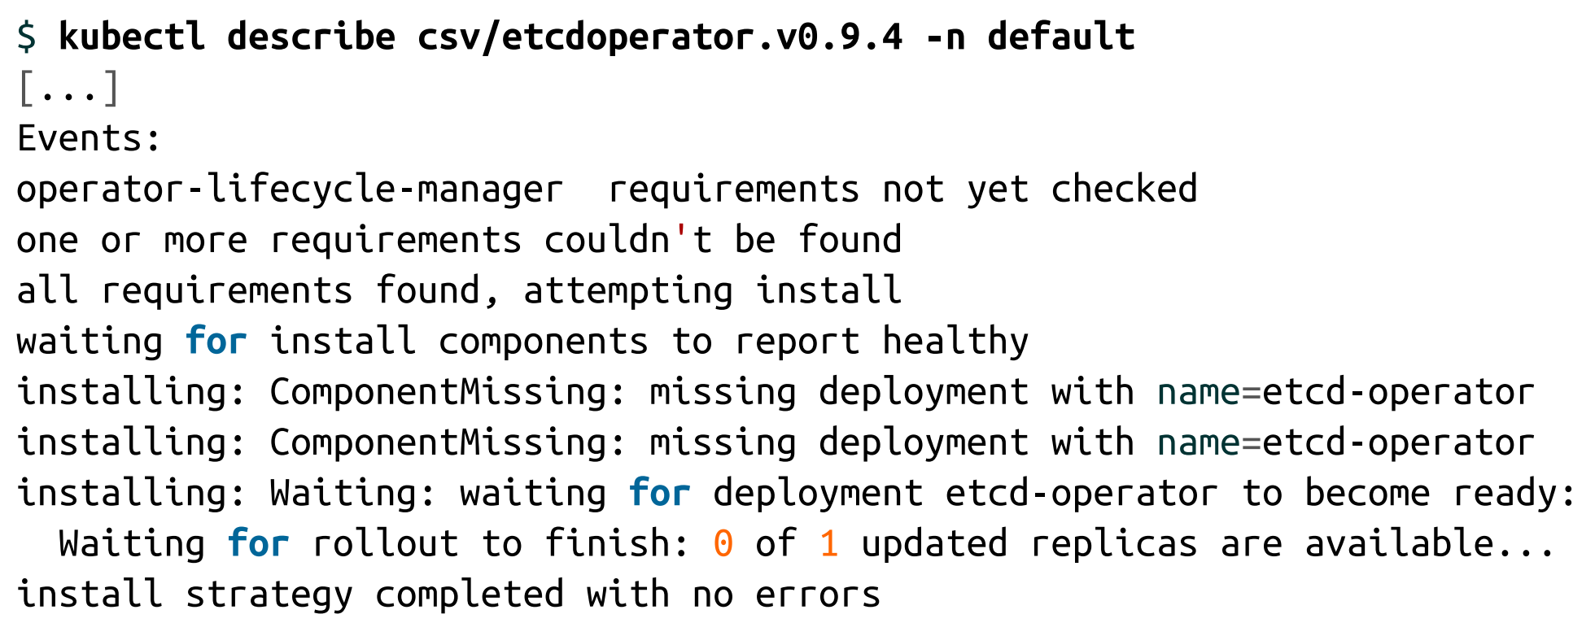
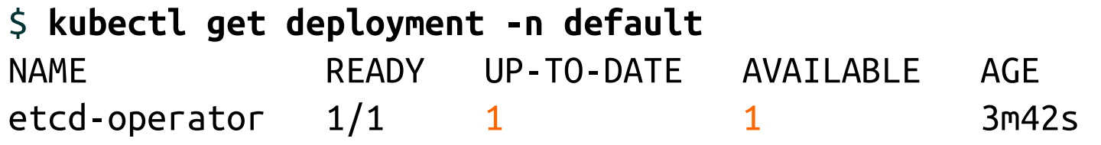
Exploring the Operator

Slide 73
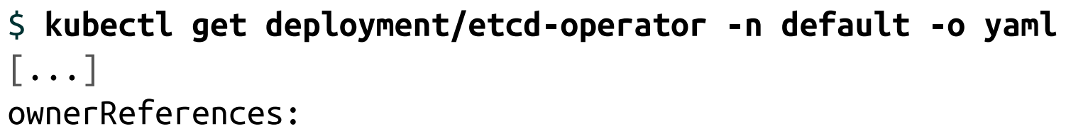
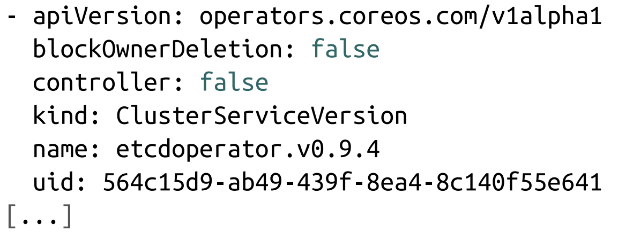
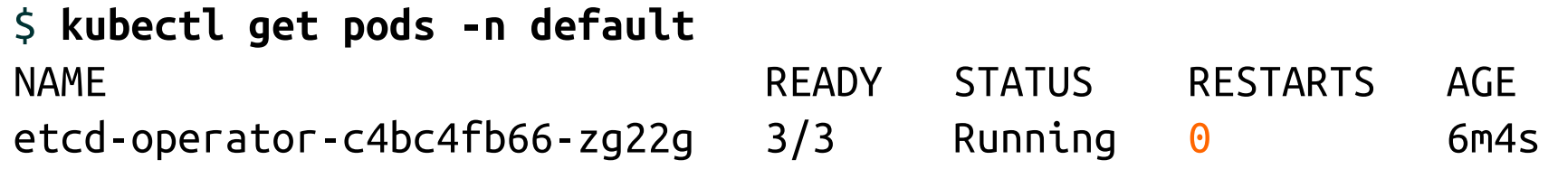
Exploring the Operator

Slide 74
Exploring the Operator
To summarize, creating the subscription caused the following to take place:
OLM creates a CSV resource in the same namespace as the subscription. This CSV contains, among other things, the manifest for the deployment of the Operator itself.
OLM uses the deployment manifest to create a deployment resource for the Operator. The owner of that resource is the CSV itself.
The deployment causes the creation of replica sets and pods for the Operator itself

Slide 75
Deleting the Operator
It’s not sufficient to simply delete the Operator’s deployment resource.
Delete the subscription to prevent OLM from installing new CSV versions in the future:

Slide 76
OLM Bundle Metadata Files
An ”OLM bundle” provides details on an Operator that can be installed. The bundle contains all the necessary information (for all the available versions of the Operator) to:
Provide a flexible delivery structure for the Operator by offering one or more channels that a user can subscribe to.
Deploy the CRDs required for the Operator to function.
Instruct OLM on how to create the Operator deployment.
Include additional information on each CRD spec field, including hints on how to render those fields in a UI.
There are three types of files included in an OLM bundle:
custom resource definitions
Cluster Service Version files
package manifest files

Slide 77
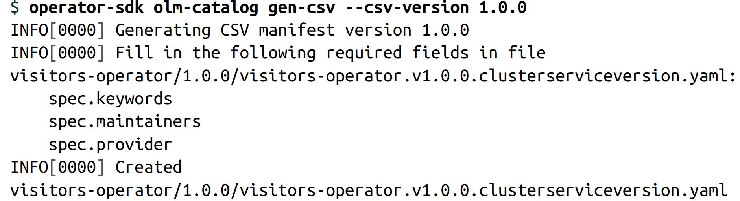
Writing a Cluster Service Version File
Generating a File Skeleton

Slide 78
Versioning and Updating
Change the new CSV filename to reflect the new version of the Operator.
Update the metadata.name field of the CSV file with the new version.
Update the spec.version field with the new version.
Update the spec.replaces field to indicate the previous version of the CSV that is being upgraded by the new version.
In most cases, the new CSV will refer to a newer image of the Operator itself. Be sure to update the spec.containers.image field as appropriate to refer to the correct image.
In the event of a CRD change, you may need to update the specDescriptor and statusDescriptor fields of the CRD reference in the CSV file.

Slide 79
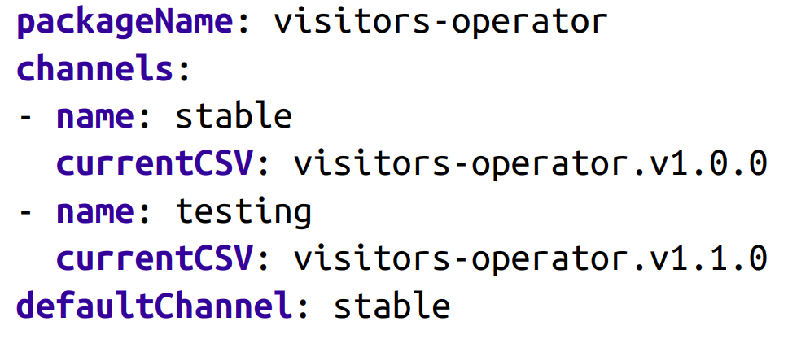
Writing a Package Manifest File

Slide 80
Publish your Operator
OperatorHub.io
https://github.com/operator-framework/community-operators/tree/master/upstream-community-operators
Quay.io

Slide 81
References
https://kubernetes.io/zh/docs/concepts/extend-kubernetes/operator/
http://www.dockone.io/article/8769
https://www.linux.com/training-tutorials/demystifying-kubernetes-operators-operator-sdk-part-2/
https://www.qikqiak.com/post/k8s-operator-101/
https://www.redhat.com/en/resources/oreilly-kubernetes-operators-automation-ebook
https://github.com/kubernetes-operators-book/chapters
https://kubernetes.io/docs/concepts/extend-kubernetes/api-extension/custom-resources/
http://dockone.io/article/9408
https://www.youtube.com/watch?v=ha3LjlD6g7g
https://www.youtube.com/watch?v=MfDpQru0-ok

